Slide 1
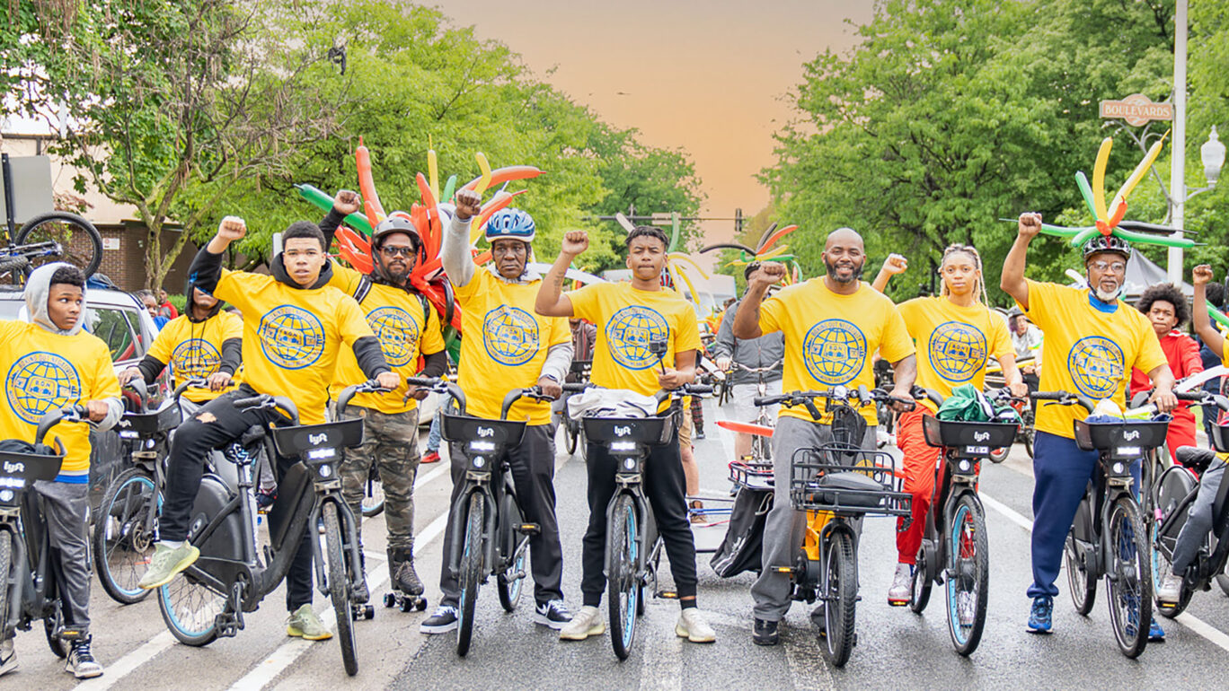
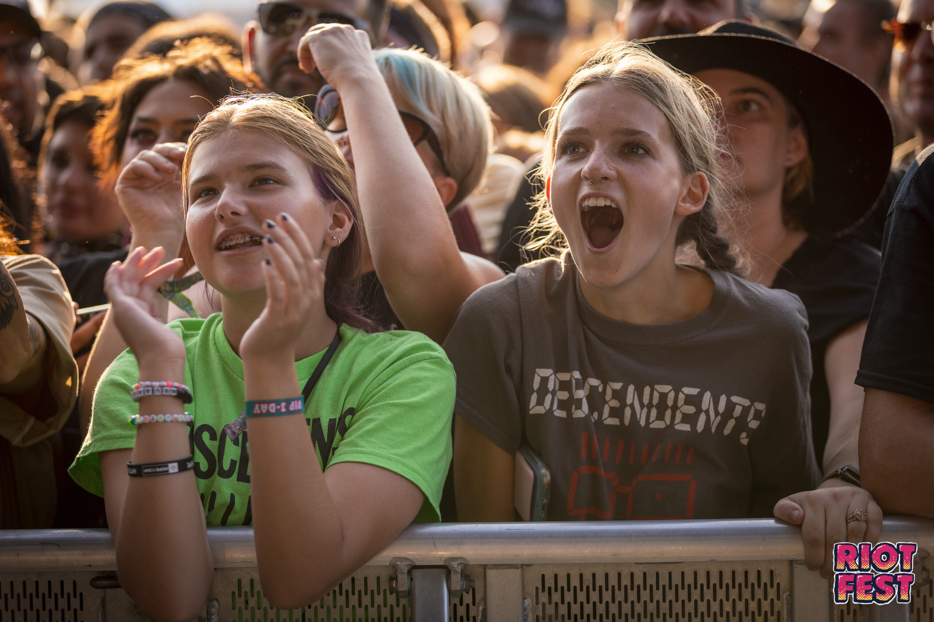
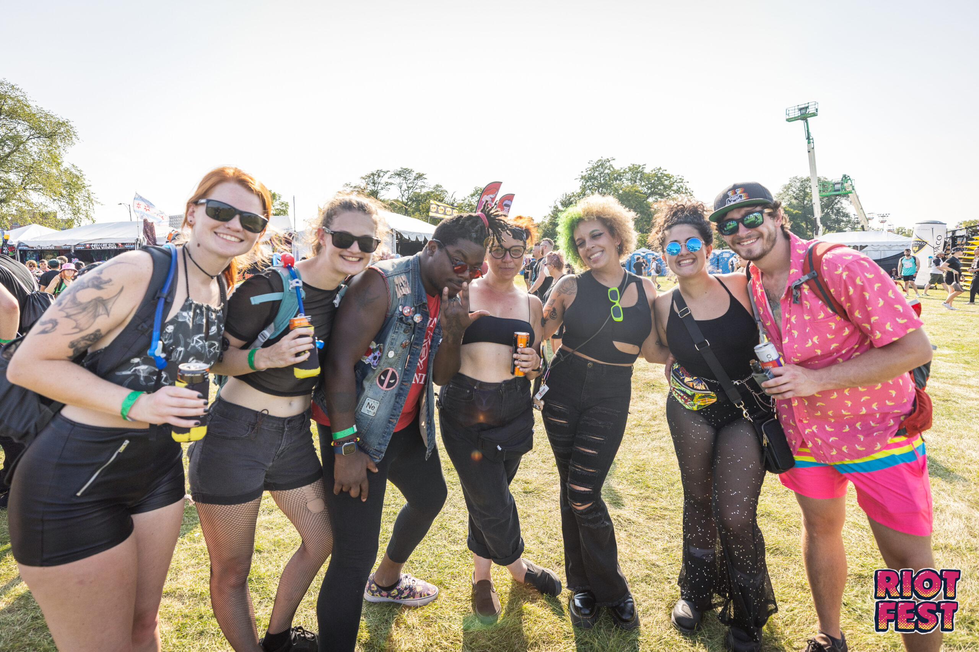
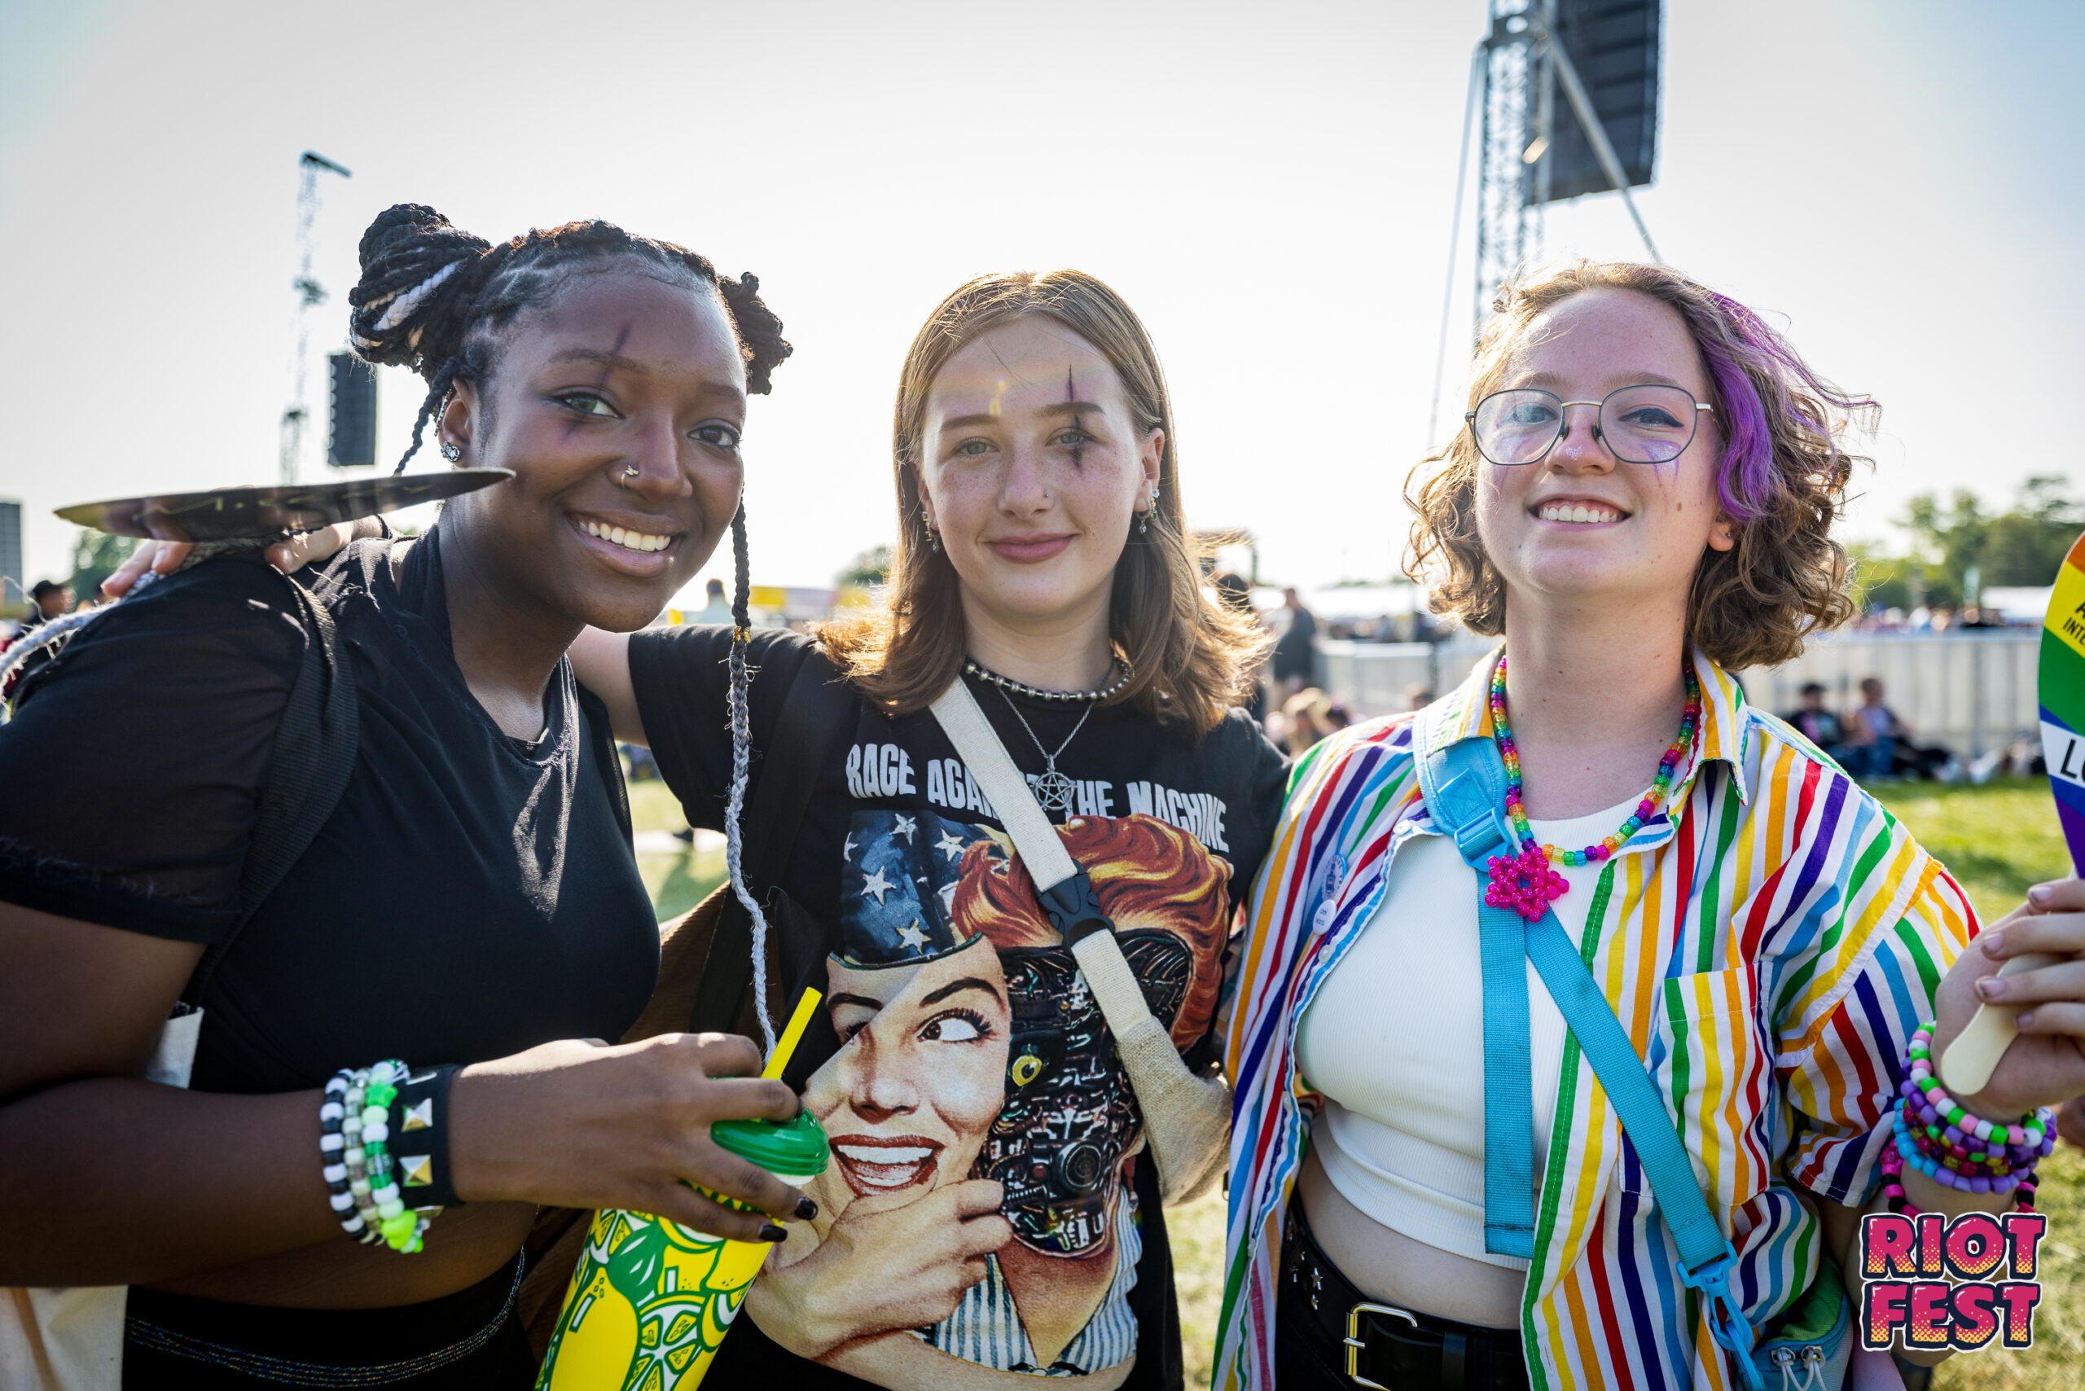
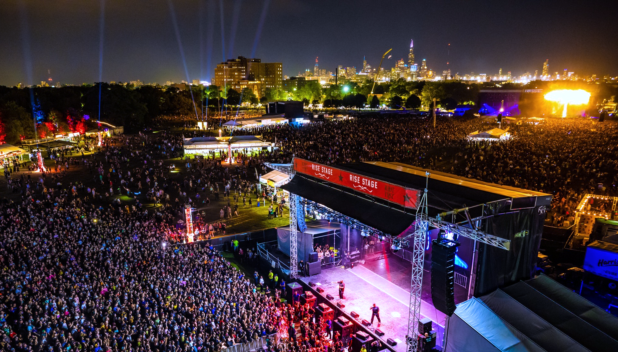
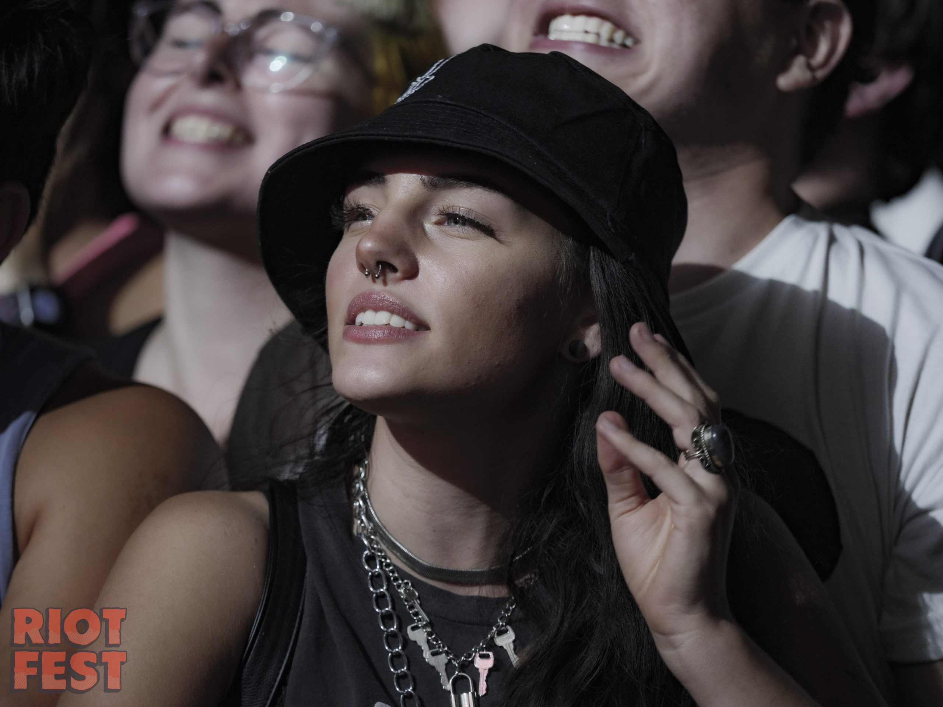
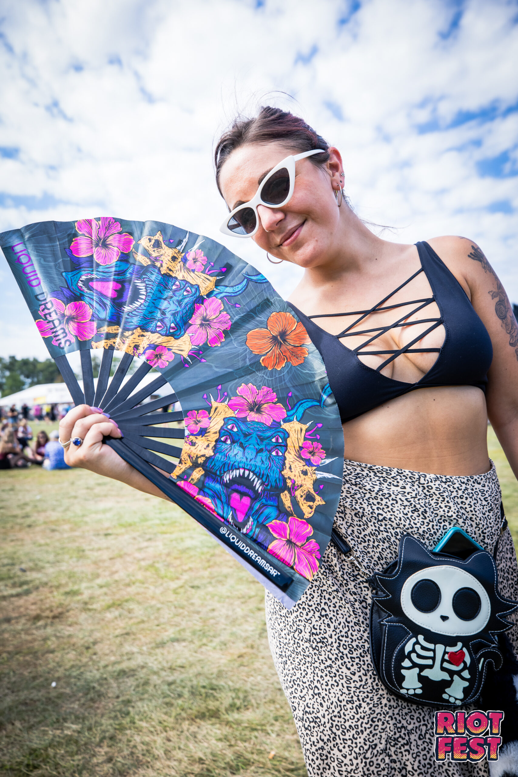
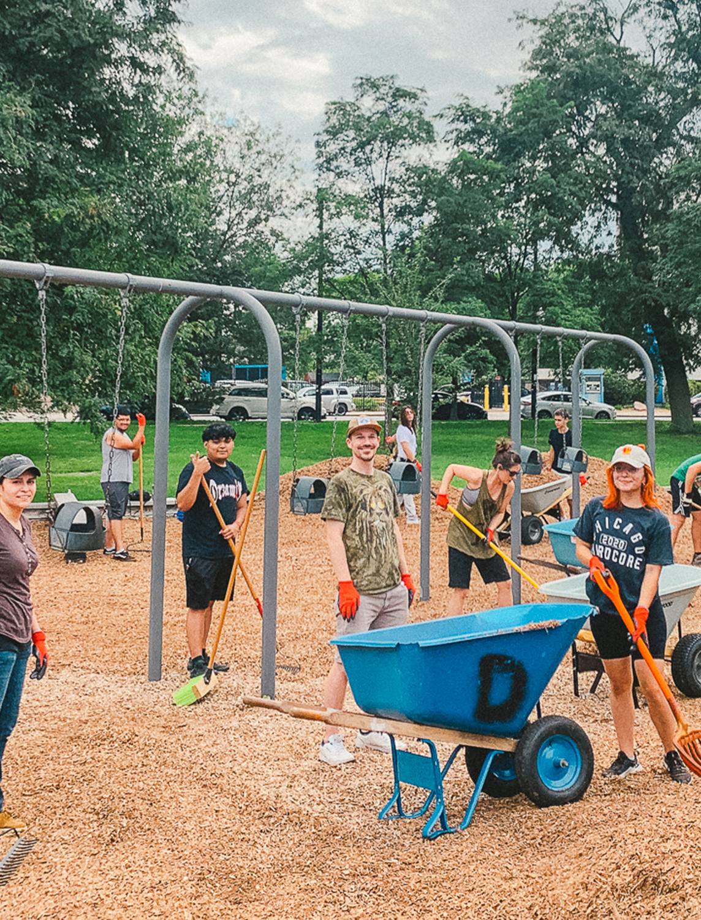
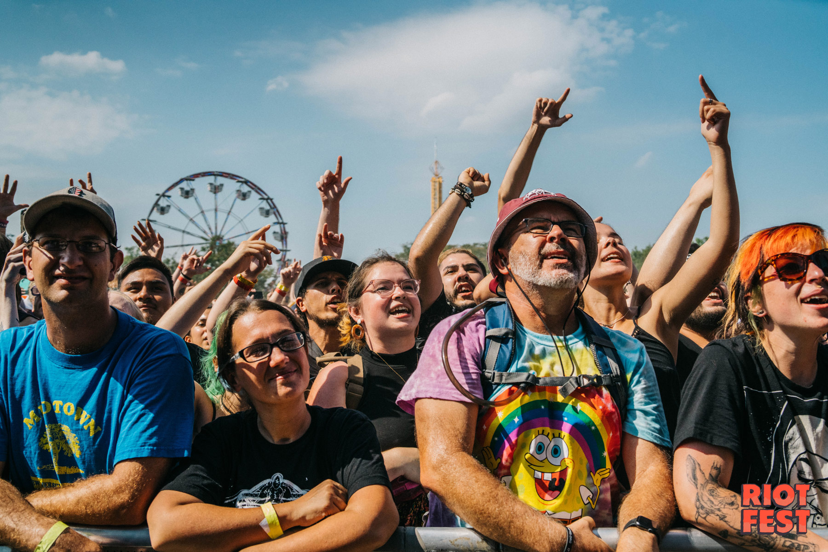
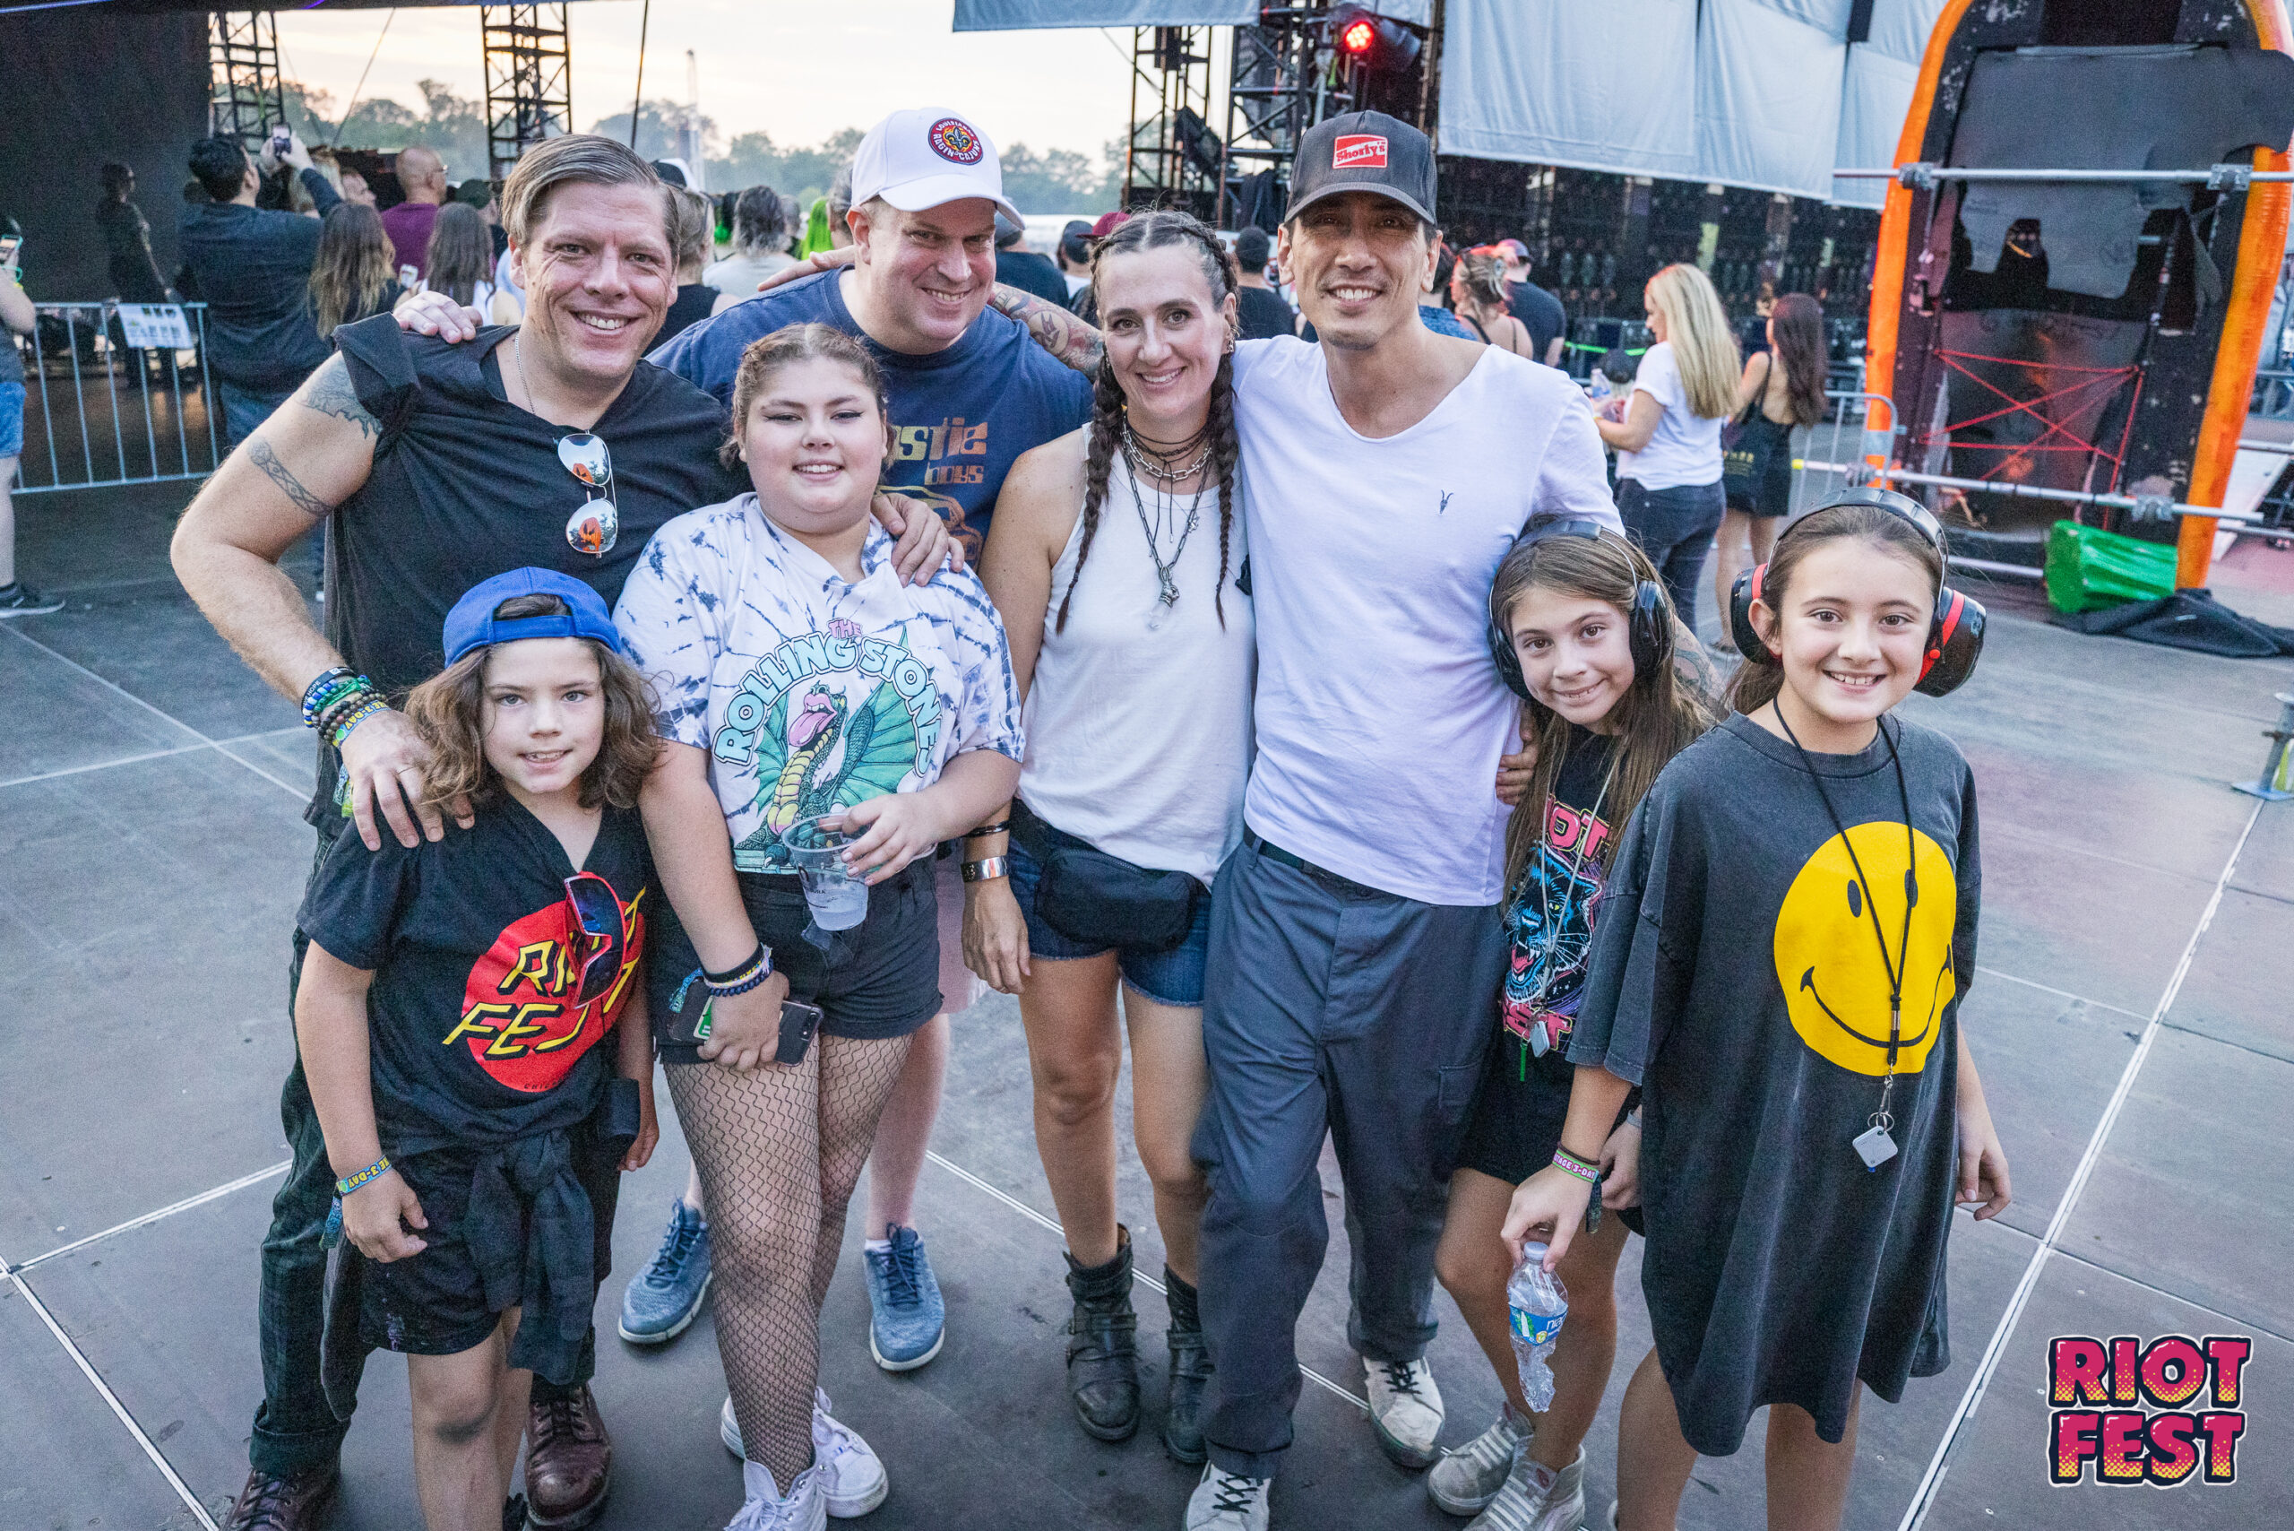
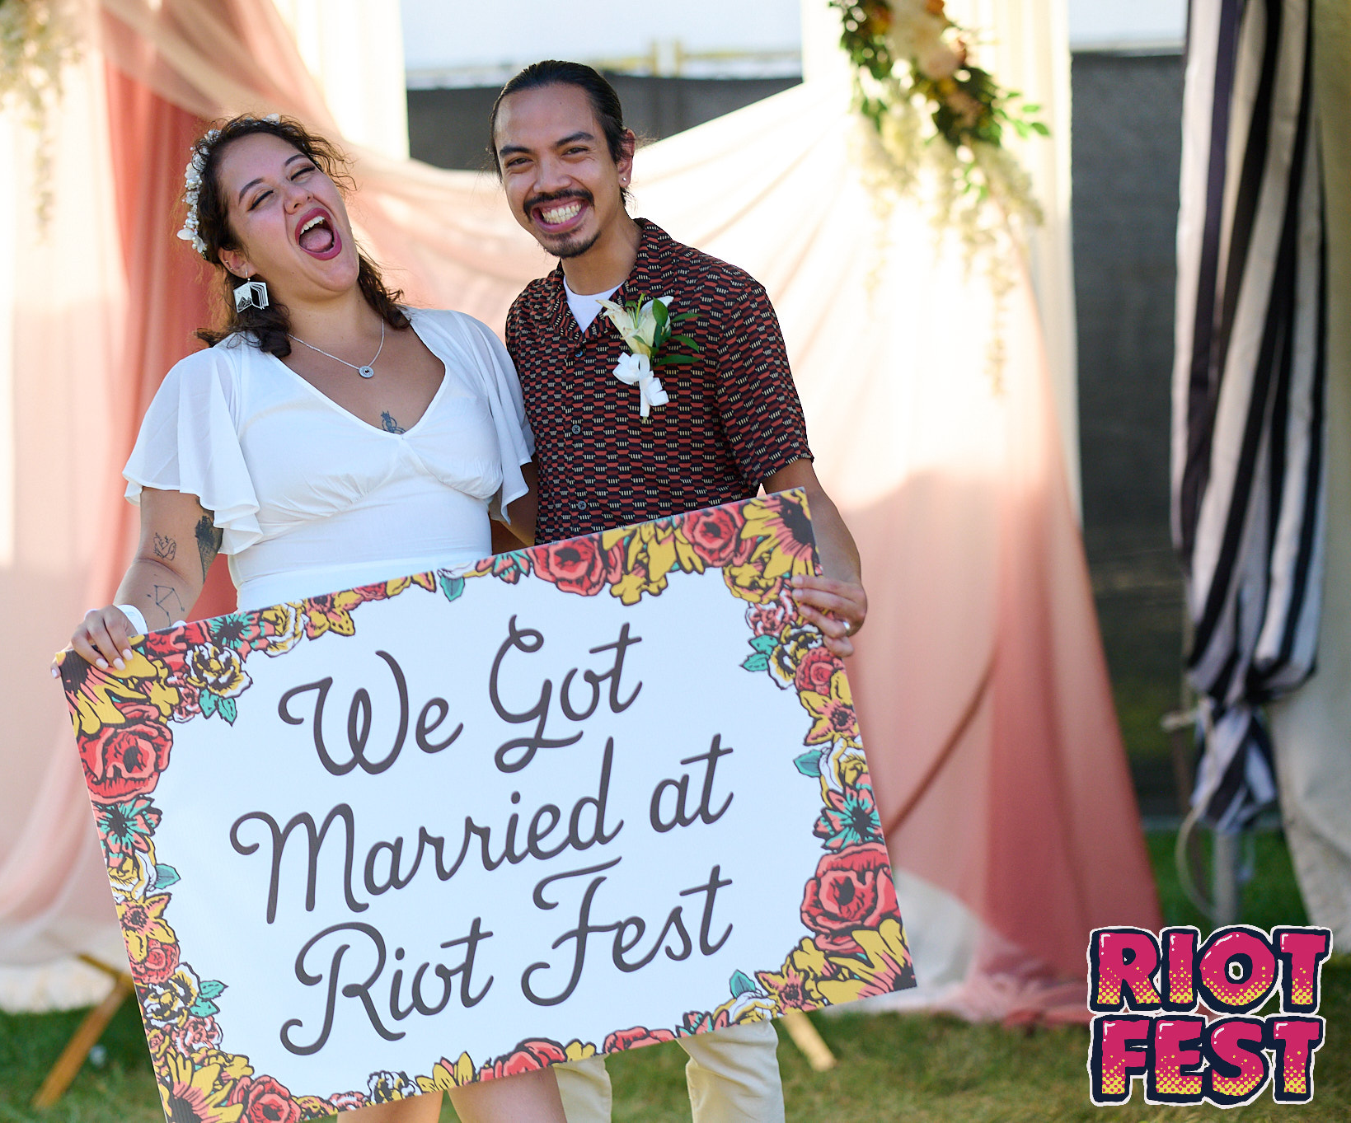
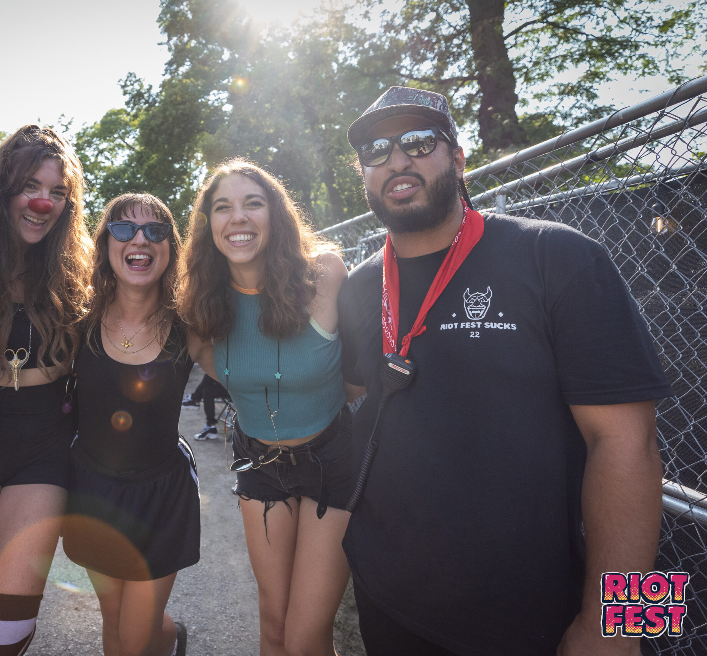
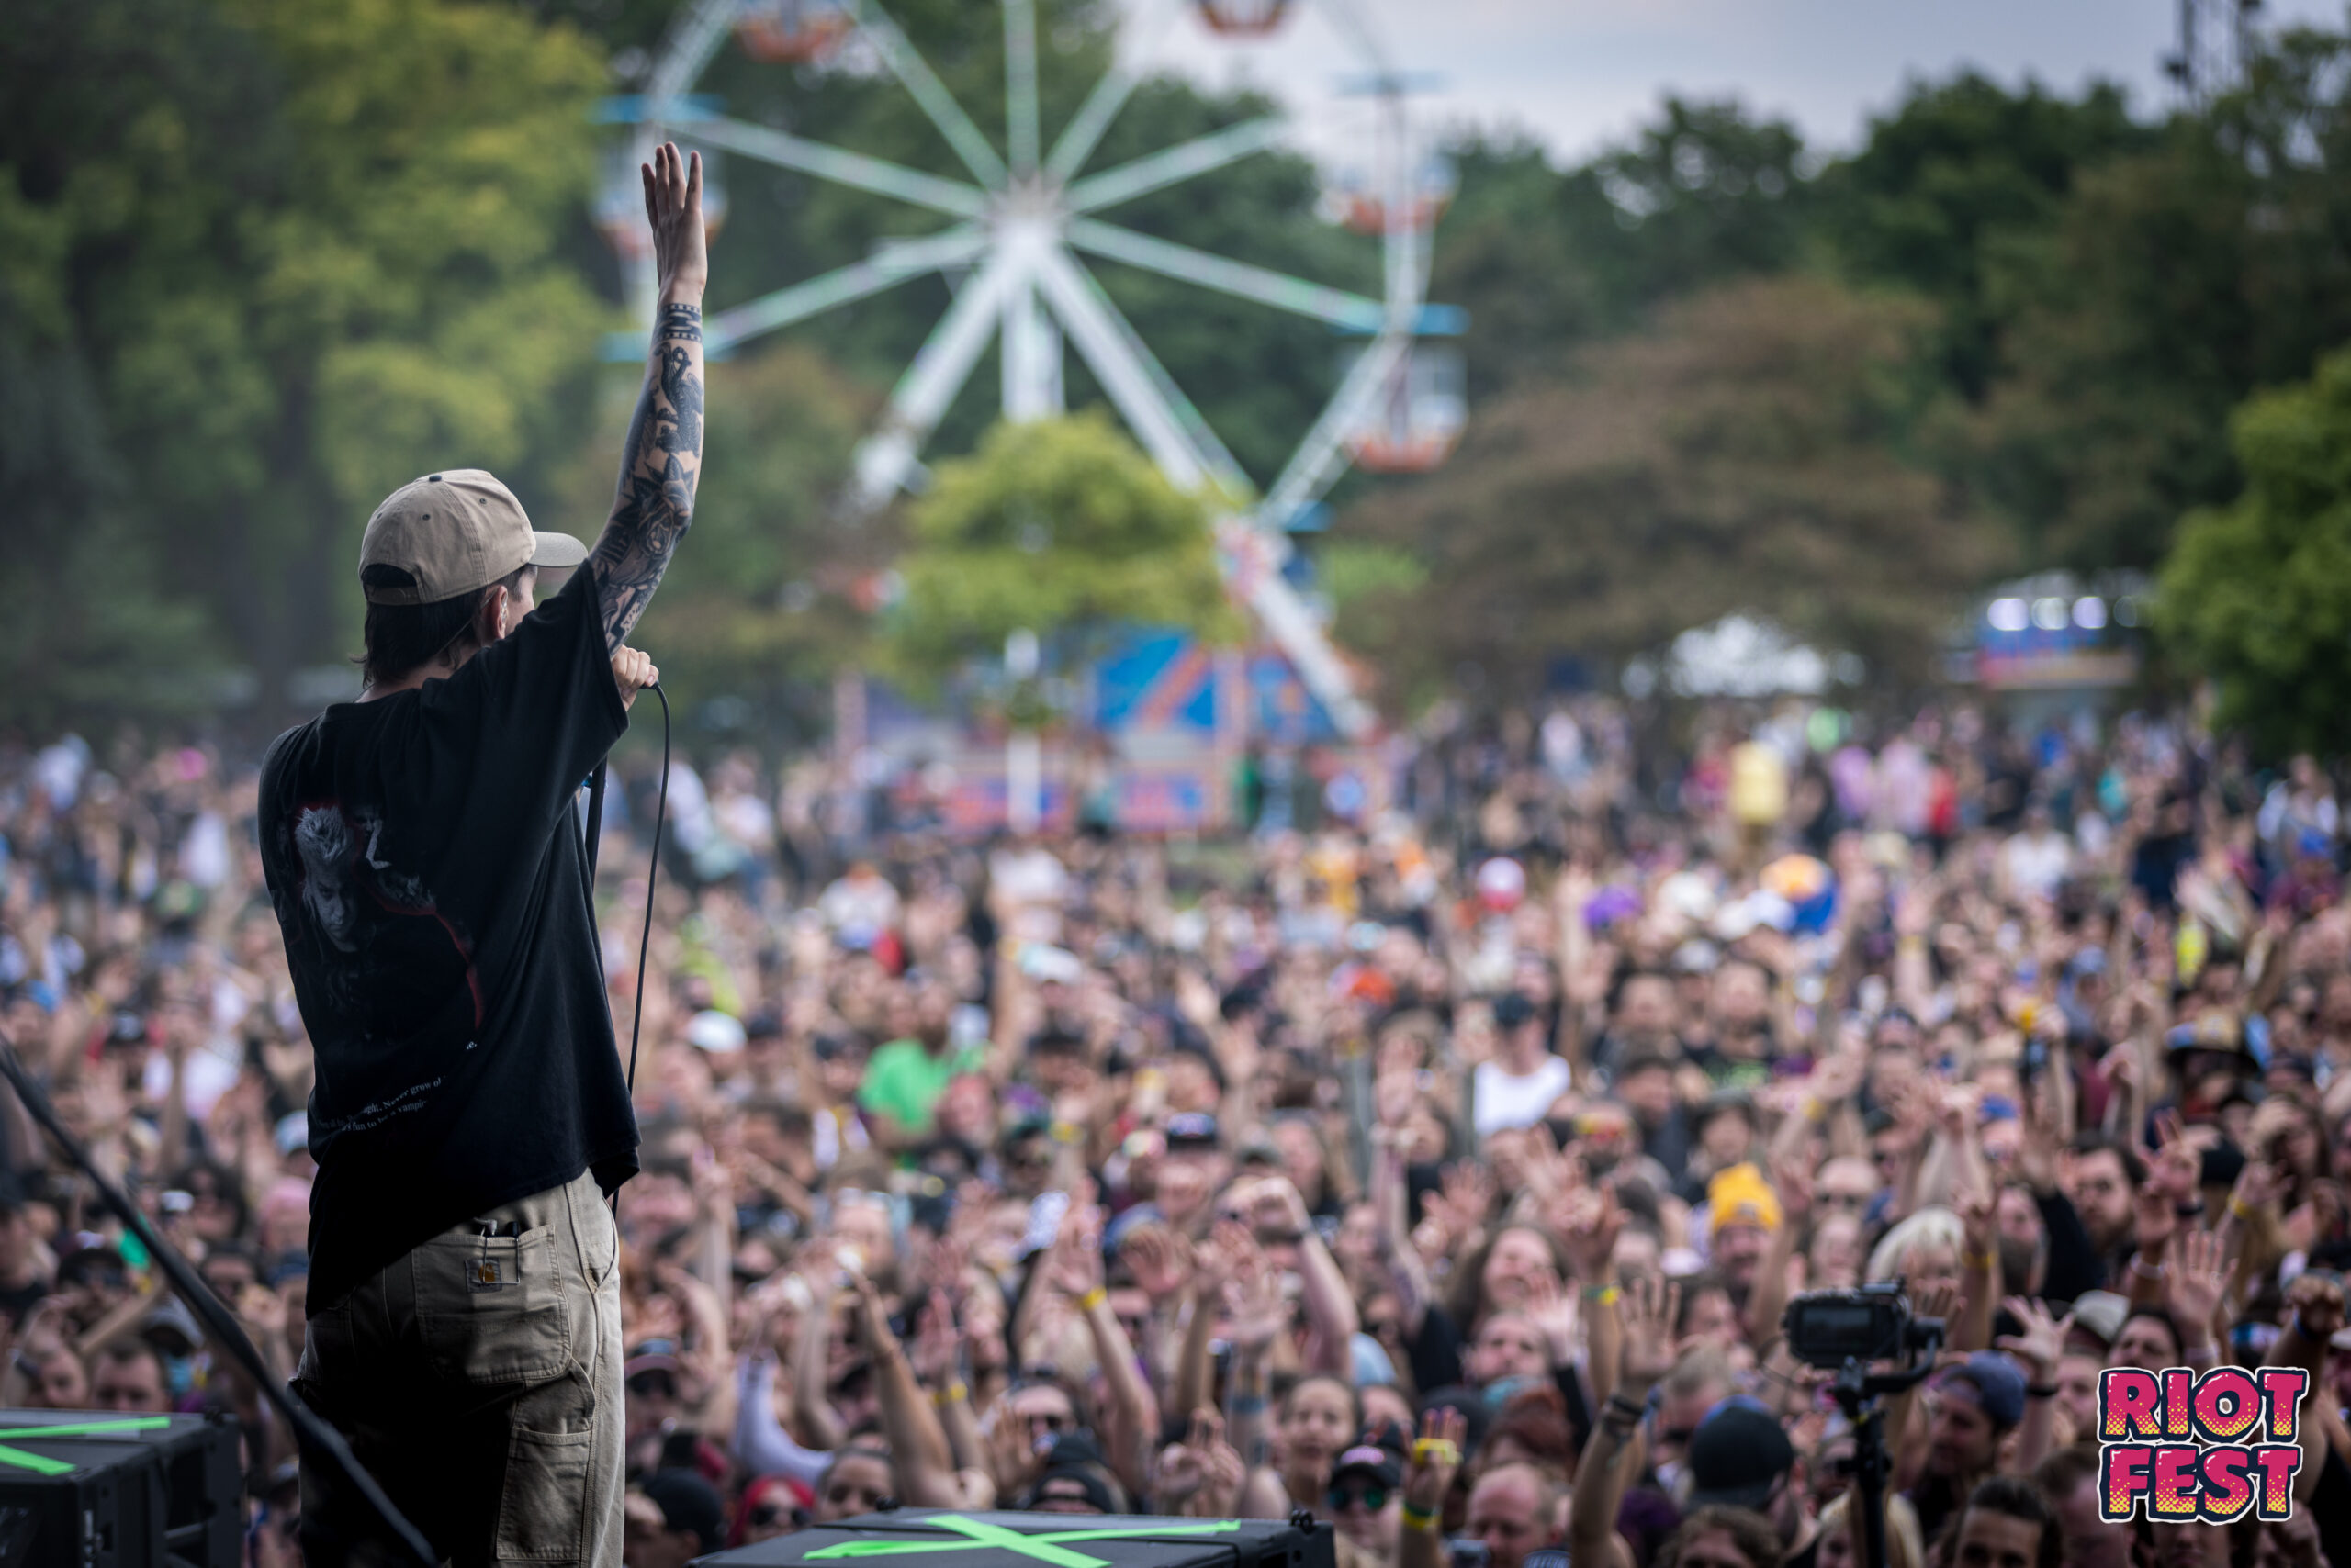
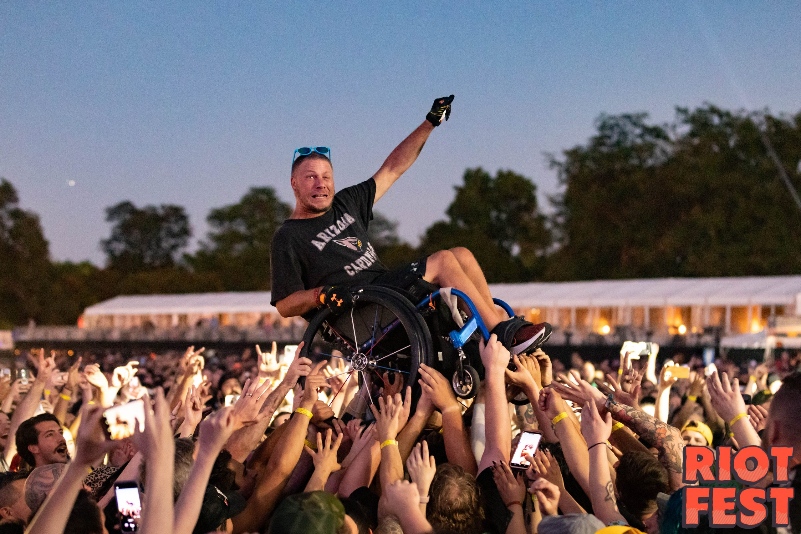
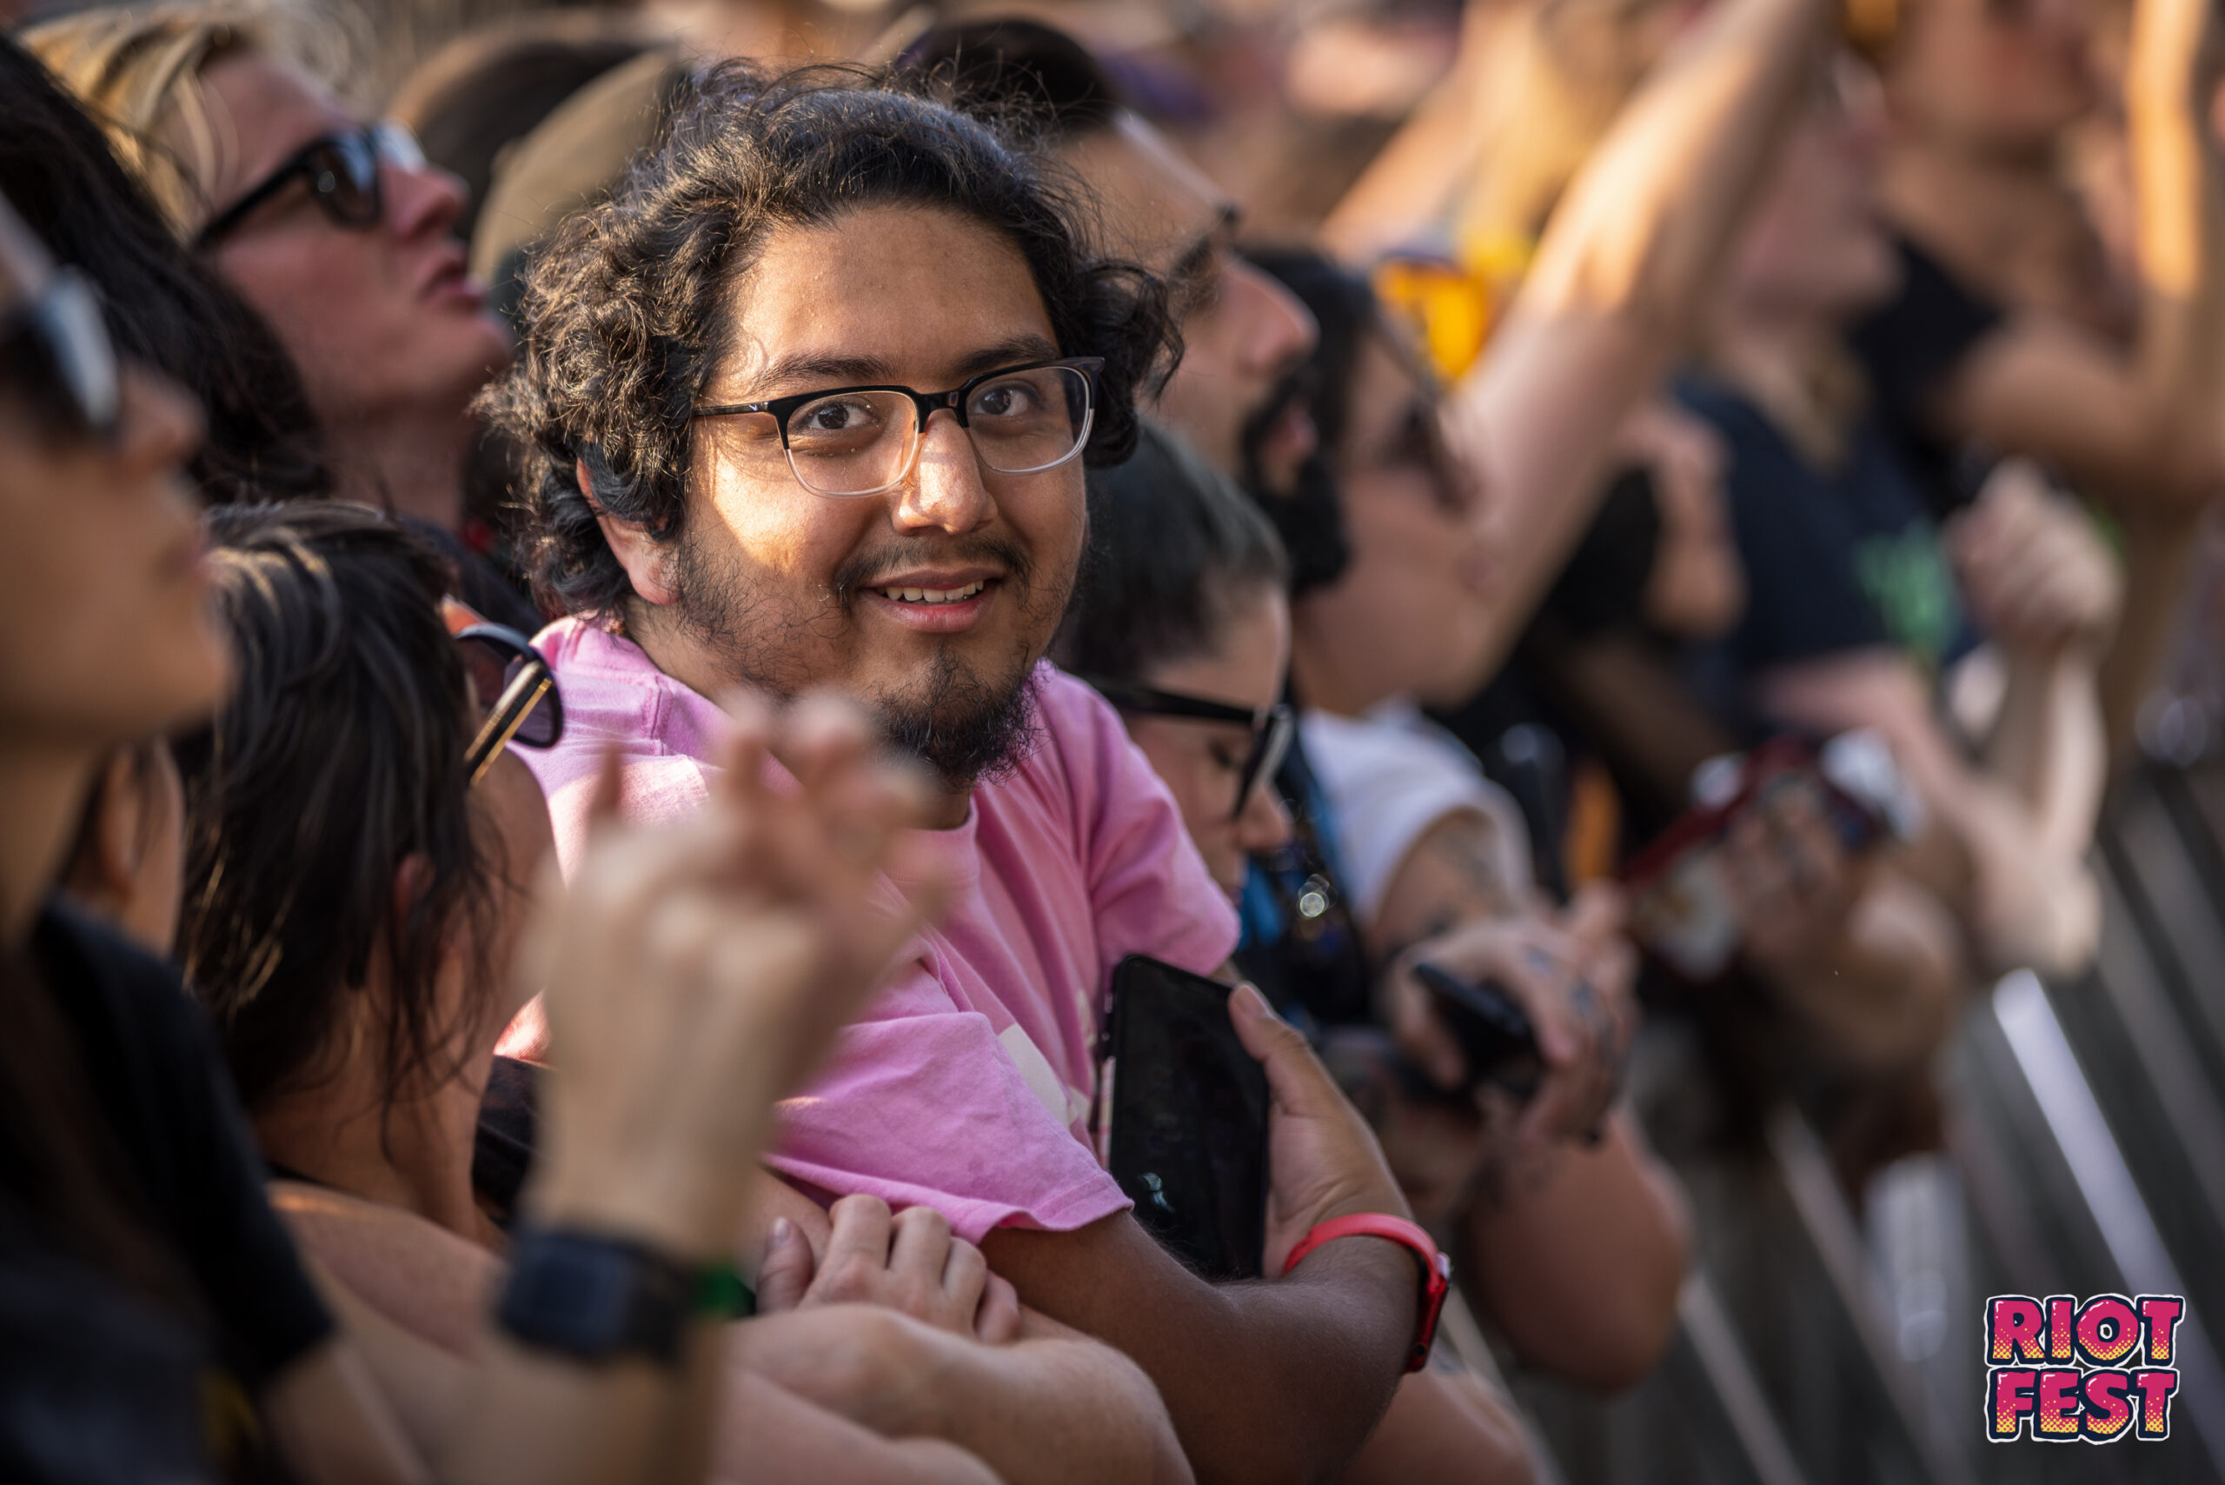
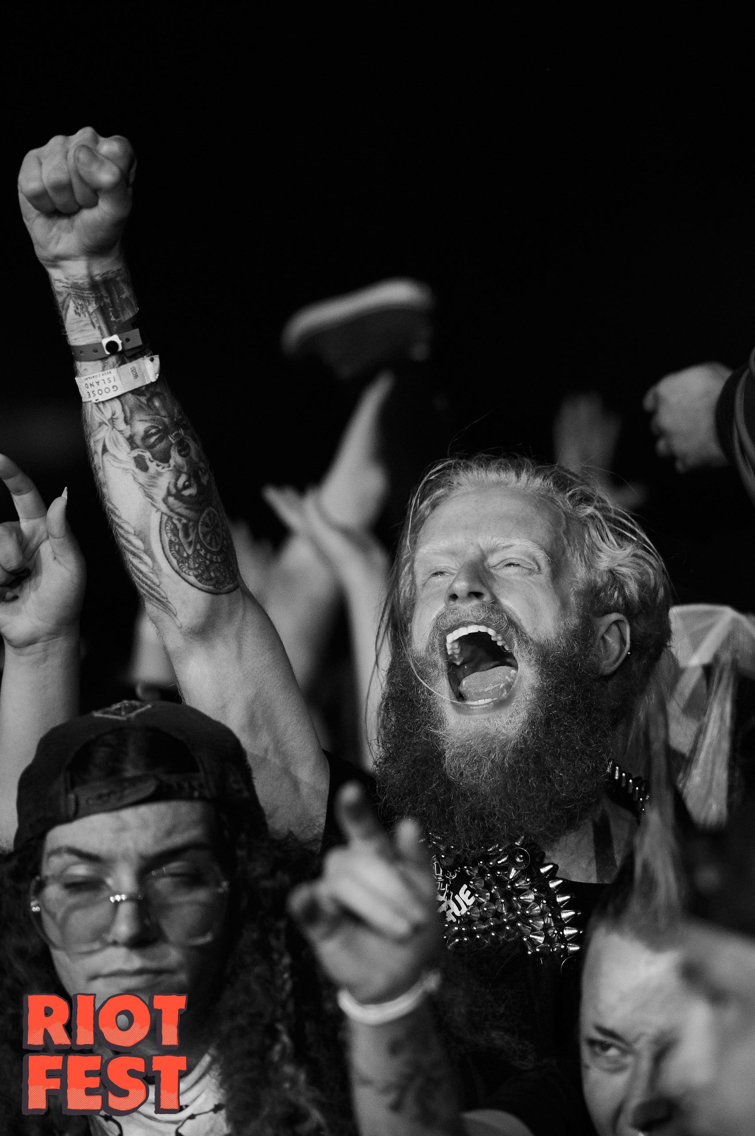
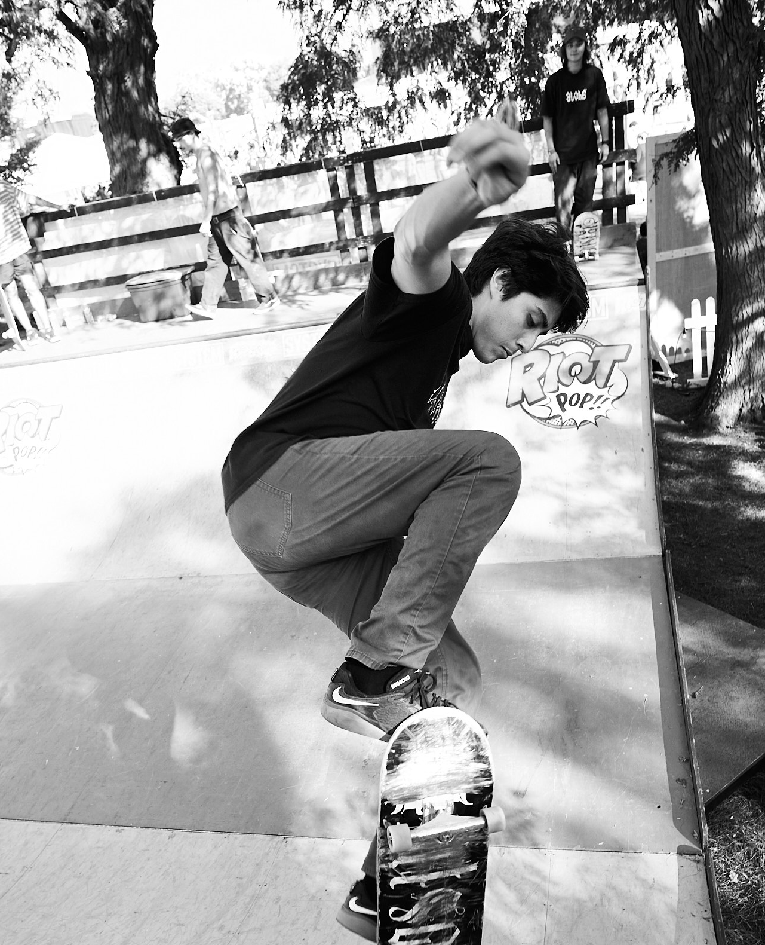
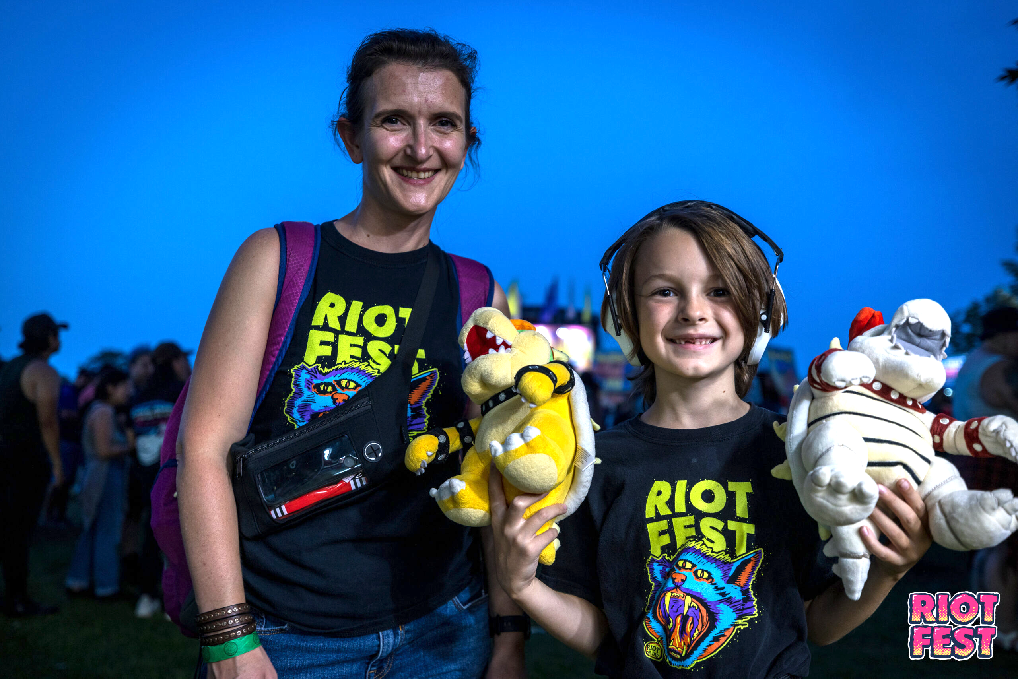
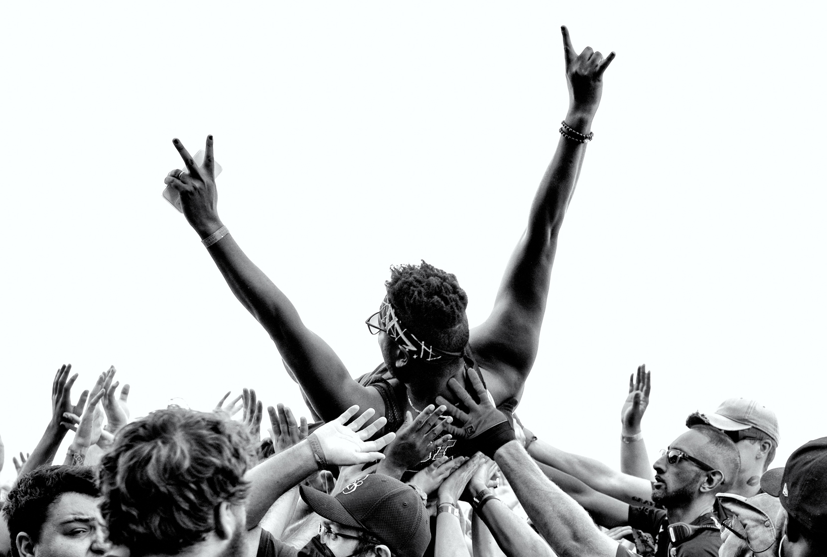
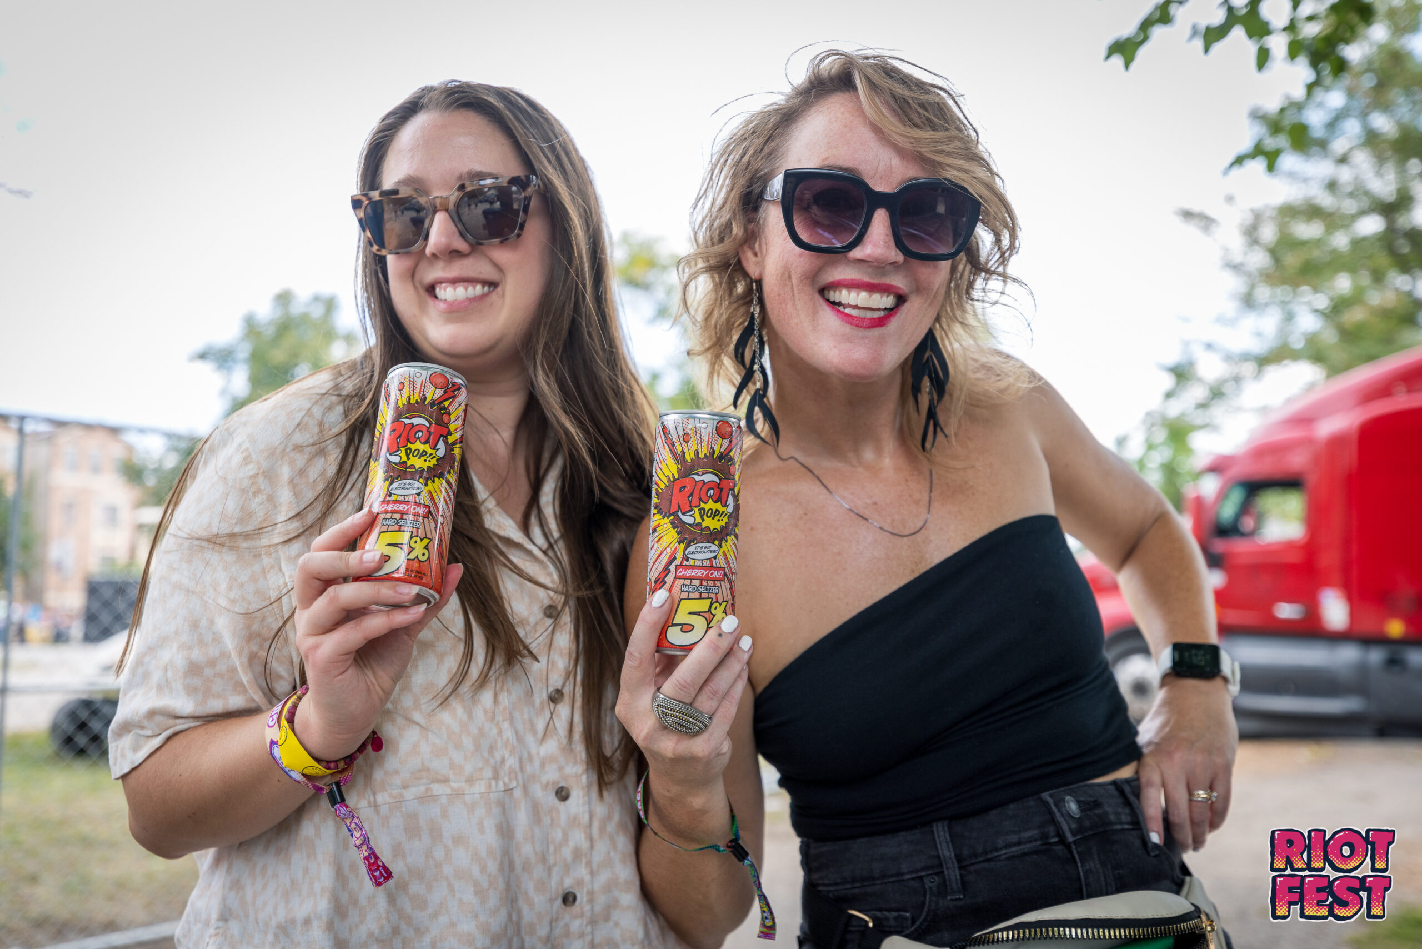
COMMUNITY ENGAGEMENT PRESENTATION 2024

Slide 2
RIOT FEST PRESENTS
TM

Slide 3
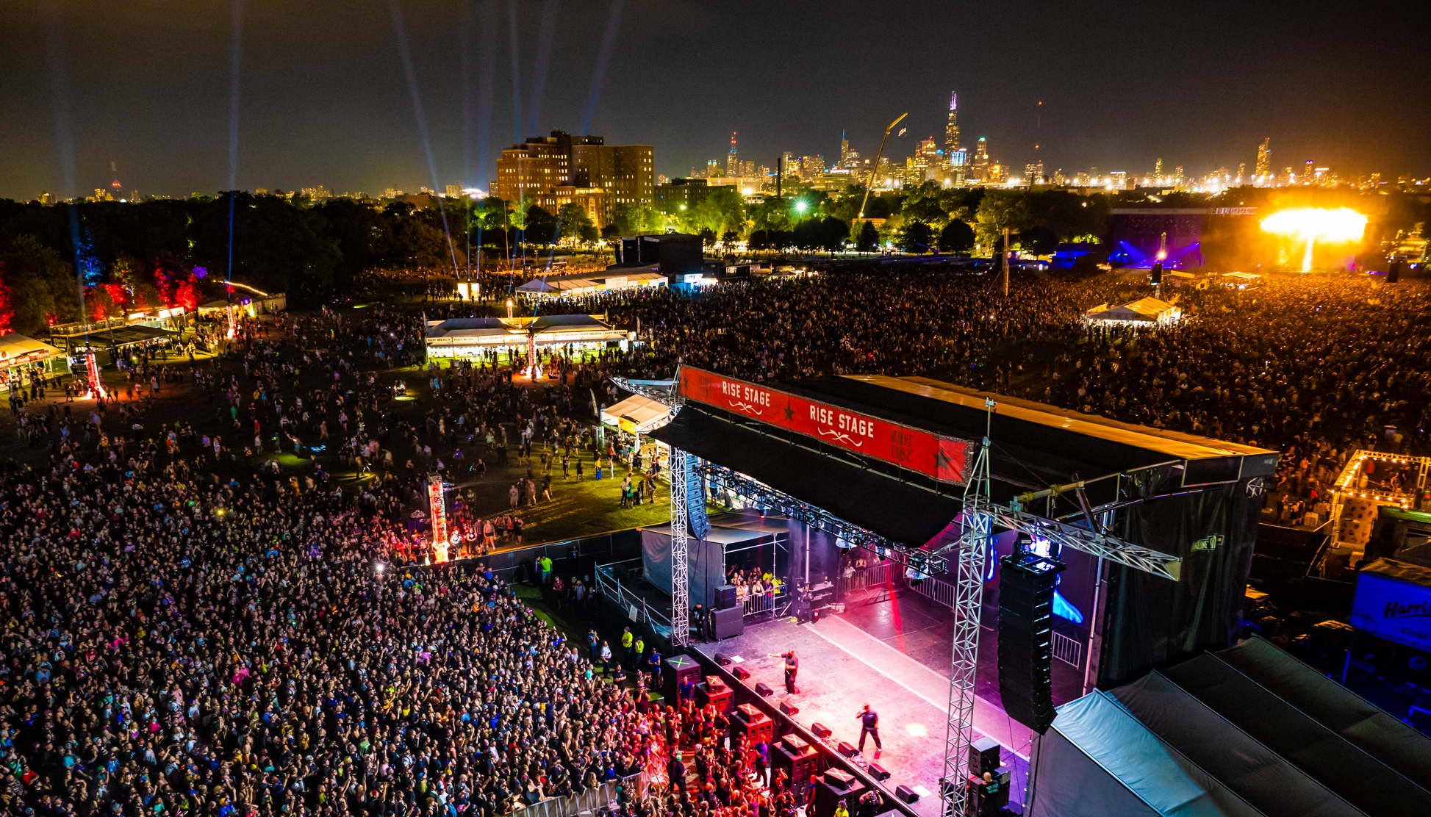
RIOT FEST PRESENTS
2023 HIGHLIGHTS & 2024 INNOVATIONS
CELEBRATING PROGRESS: AIMING HIGHER

Slide 4
RIOT FEST - DOUGLASS PARK
September 20 - 22, 2024
Multi-generational 3 day music festival
Diverse genres: punk, rock, alternative, reggae, metal, and hip-hop
Features local and national artists, carnival rides, food vendors, merchandise, and community partners
COMMITTED TO THE COMMUNITY
Hosted in Douglass Park since 2015
Focus on inclusivity and diversity for all audiences and ages
INDEPENDENT AND AUTHENTIC
Largest independent music festival in North America
Committed to authenticity and creativity
RIOT FEST PRESENTS
TM

Slide 5
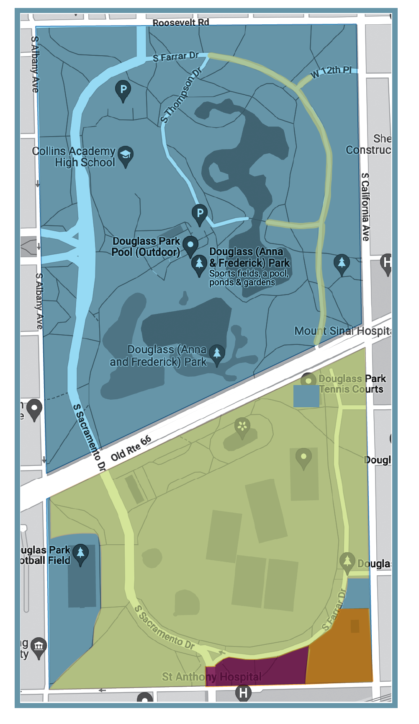
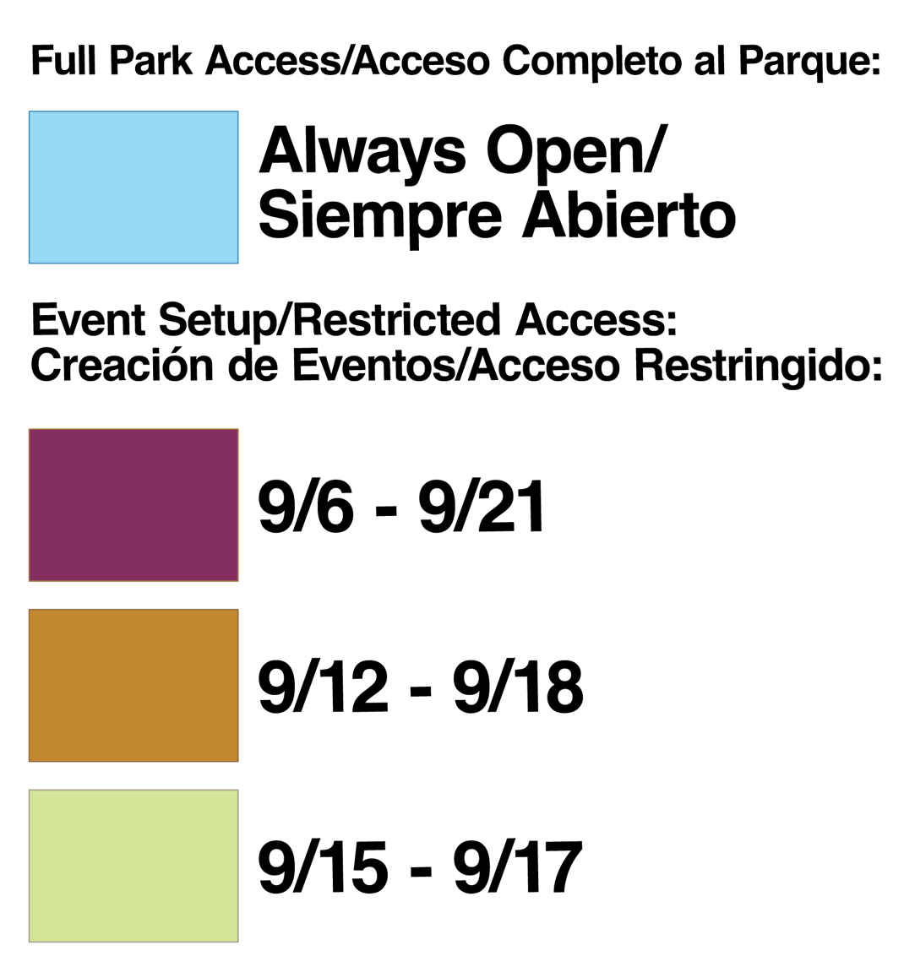
MAINTAINING ACCESSIBILITY
PRIORITIZING COMMUNITY ACCESS TO DOUGLASS PARK
WILL REMAIN OPEN & NEVER CLOSE
Douglass Park - Roosevelt Rd. to Ogden Ave.
Tennis court
Football field
Track and field
Kids playground | 19th and Albany
Kids playground | 18th and California
2024 TIMELINE | SEPTEMBER 11 - 26
September 11: Load-in begins. Crews start installing perimeter fencing and flooring
September 12 - 19: Crews begin assembling stages and other production
September 19: 10:00 PM, the park closes to the public
September 20 - 22: Festival show days
September 23 - 26: Production loadout, cleaning and restoration
September 27: Park fully open to the public
9/11 – 9/26
9/17 – 9/23
9/20 – 9/22

Slide 6
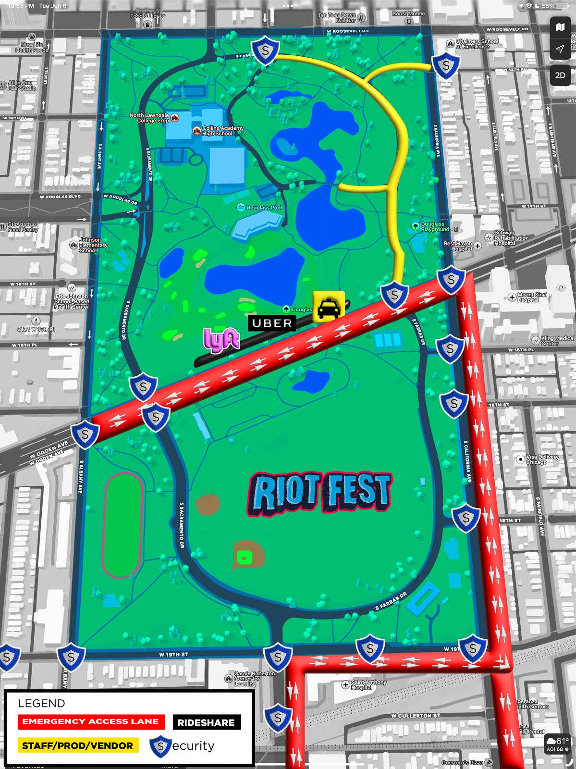
2024 PROPOSED MEASURES
2023 RECAP ON STRATEGIC MEASURES
EMERGENCY ACCESS: Our collaborative route development ensured unobstructed and efficient access for emergency vehicles, facilitating prompt response times
CHECKPOINTS & BARRICADES: Trained personnel at strategic checkpoints ensured smooth traffic flow and heightened security. The setup effectively managed crowd movement and restricted access.
COMMUNICATION & SIGNAGE: Our signage at checkpoints and distributed traffic plans were effective. However, feedback suggests areas for potential improvement
RESIDENTIAL PARKING: Implementing 'Resident Parking Only' signs was successful in managing congestion and unauthorized parking in residential areas. Improvements for 2024: Deploy more 'No Parking' signs based on residents' requests
RIDESHARE & PUBLIC TRANSPORTATION: While dedicated zones, increased public transport frequencies, and rideshare geo-fencing were set, the drop-off issues near Mount Sinai were a concern. We will place a stronger emphasis on communication with rideshare companies to highlight these critical no-drop zones for the next festival

Slide 7
2024 PROPOSED MEASURES
2023 RECAP ON STRATEGIC MEASURES
OFF-SITE PARKING: Our strategy to secure parking at UIC was effective in dispersing traffic and offering ample space for attendees. We are currently exploring additional parking locations for 2024
STAFF & VENDOR PARKING: By designating parking for our staff and vendors on North Farrar Drive, we managed to significantly reduce congestion in residential zones and prevented our staff from parking in these areas.
ATTENDEE ENGAGEMENT: Proactive pre-event communications about traffic measures, parking, and transport options ensured attendees were well-informed, leading to a streamlined experience for all
FEEDBACK FROM THE 10TH DISTRICT POLICE COMMANDER: The10th district police commander was pleased with 2023's results, highlighting the added perimeter security. Moving Riot Fest's 2024 dates to avoid the Mexican Independence Day Parade was well-received, aiding resource allocation for the 10th District Police Station and other Chicago agencies.
MEXICAN INDEPENDENCE DAY PARADE 2024: In a recap discussion, the Little Village Chamber Of Commerce voiced their appreciation regarding the proactive measures taken for community safety. The decision to move Riot Fest's 2024 dates was particularly appreciated as it ensures that city services and safety will not be compromised due to overlapping events
ALDERWOMAN MONIQUE
WORKING TOGETHER WITH
24th Alderwoman Monique Scott
City Of Chicago
Chicago Park District
Mount Sinai & Saint Anthony’s Hospital
Community Stakeholders
Local Residents

Slide 8
MOUNT SINAI & SAINT ANTHONY HOSPITAL
2023 RECAP & IMPROVEMENTS FOR 2024
SAINT ANTHONY’S HOSPITAL FEEDBACK
No complaints from hospital guest, staff, or patients
Improved cell phone reception
Improved access to and from the hospital
Employee parking with banners was effective
Additional check points worked for traffic flow
Emergency vehicles had no issues with access
Improvement Needed:
Faster screening of vehicles at the access gate on 19th & Marshall to minimize backup
Add cell phone towers near 19th street & Marshall for improved coverage
KEY STRATEGIES THAT WORKED IN 2023
Directional Speakers positioned away from nearby hospitals and residences
Controlled DB Levels: Audio engineer regulates sound levels to Max 95db
Hard Limit Levels: 'Hard limit' levels to prevent unexpected volume surges
Advanced P. A. System: Beam steering technology for enhanced sound directionality
Active Monitoring: Real-time noise monitoring for prompt adjustments
Additional security at key locations and checkpoints
Signage for employee parking
Improved communications for faster and uninterrupted access for emergency vehicles
MOUNT SINAI HOSPITAL FEEDBACK
No complaints from hospital guest, staff, or patients
Better access and traffic flow to the hospital
Extra security at key locations worked
Emergency vehicles had no issues with access
Improvement Needed:
Improve on rideshare Pick-ups & drop-offs near the emergency entrance

Slide 9
RIOT FEST PRESENTS
A CELEBRATION OF COMMUNITY: MORE THAN JUST A MUSIC FESTIVAL

Slide 10
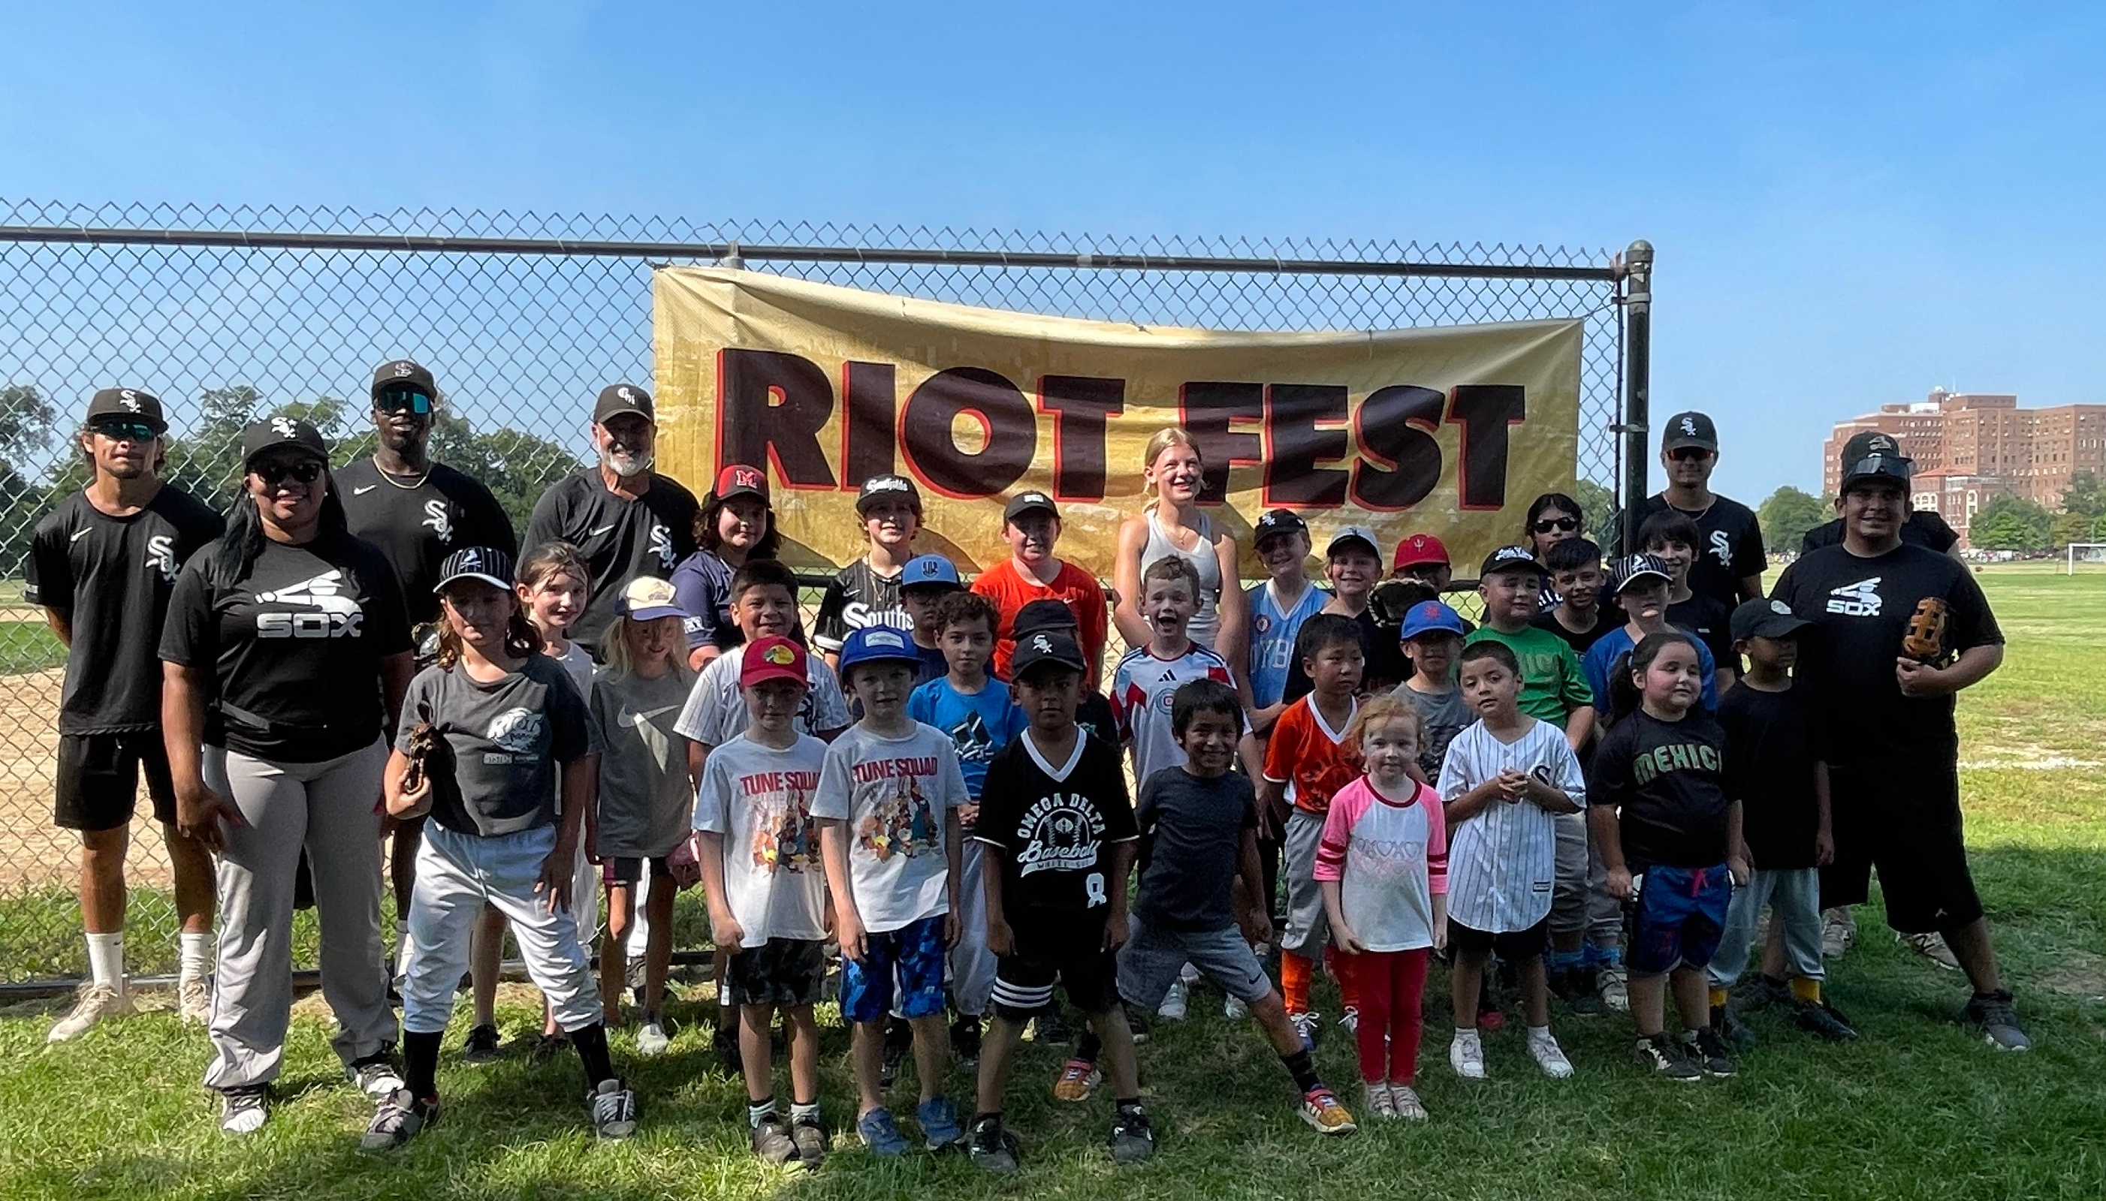
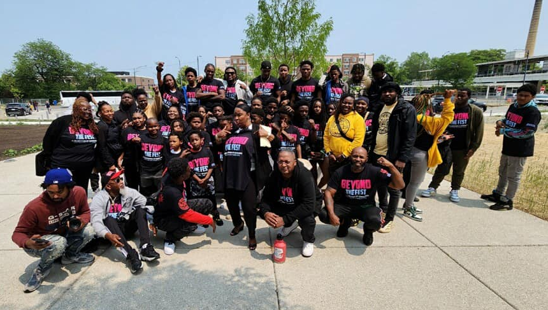
2023 COMPLETED EVENTS & INTIATIVES
HIGHLIGHTS & ACHIEVEMENTS
LOCAL VENDOR WORKSHOPS – LITTLE VILLAGE & NORTH LAWNDALE
3 JOB FAIRS
3 PARK CLEANUPS
TICKETS FOR LOCAL RESIDENTS
RIOT FEST INTERNSHIP LOCAL BANDS AT THE FEST
COMMUNITY SPOTLIGHT (HIGHLIGHTING LOCAL BUSINESSES)
COMMUNITY CORNER @ RIOT FEST
BOXING OUT NEGATIVITY JUNETEENTH EVENT
HARMONY COMMUNITY CARE FOOD PANTRY
VILLAGE LEADERSHIP ACADEMY JUNETEENTH EVENT
HAMMOND COMMUNITY GARDENS PROJECT
STREET LOVE RIDE PARTNERSHIP
LITTLE VILLAGE ROTARY CLUB 5k PEACE RUN
26TH STREET CARNIVAL & FAIR
BOXING OUT NEGATIVITY BACK TO SCHOOL
WHITE SOX BASEBALL YOUTH CAMP
WHITE SOX ANTIBULLYING WITH SAUCEDO SCHOOL
BOOK DRIVE FOR CHICAGO YOUTH CENTER
LEARN CHARTER DECISION NIGHT
SHARE THE WARMTH COAT DRIVE
HAMMOND ELEMENTARY SCHOOL – LITTLE LIBRARY
DOUGLASS PARK ADVISORY COUNCIL COMMEDY SHOW
24th WARD CHRISTMAS TREE LIGHTING
SANTAS WORKSHOP TOY GIVEAWAY @ SOULE
HOLIDAY TOY GIVEAWAY – SUMNER MATH & SCIENCE ACADEMY & CROWN ACADEMY

Slide 11
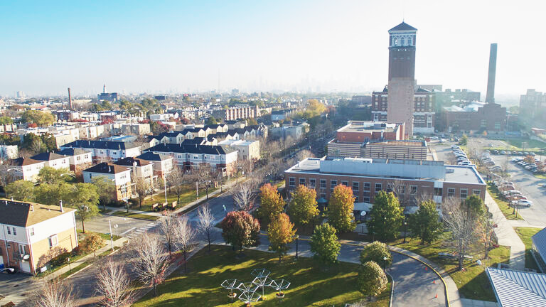
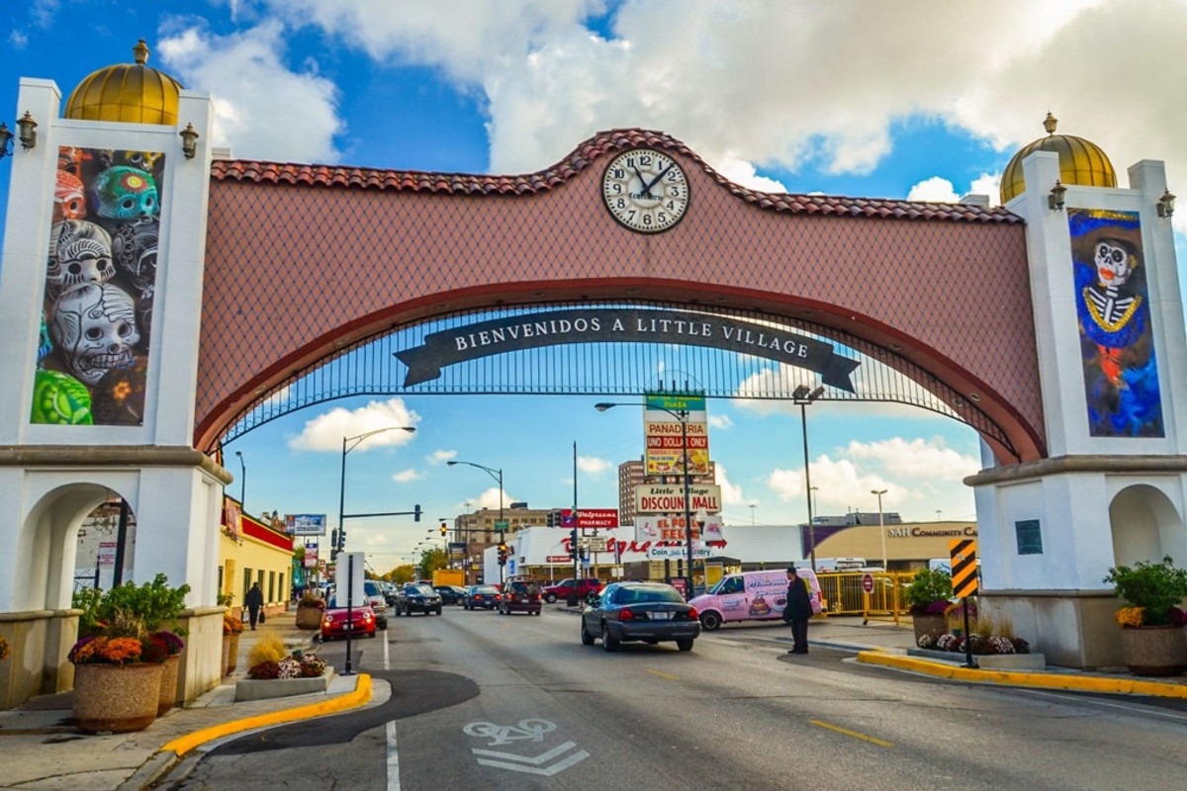
2024 UPCOMING EVENTS & INTIATIVES
HIGHLIGHTS & ACHIEVEMENTS
NORTH LAWNDALE EAGLES 34th ANNIVERSARY – MARCH 16th
EASTER EGG HUNT WITH DPAC - MARCH 31st
BIKE OUT NEGATIVITY – MAY 18th
LITTLE VILLAGE ROTARY CLUB (CARRERA POR LA PAZ) MAY 18th
BOXING OUT NEGATIVITY - JUNETEENTH
VILLAGE FEST - JUNETEENTH
FATHER’S DAY FAMILY PHOTO’S – JUNE 6th
WHITE SOX BASEBALL YOUTH CAMP – JUNE 22nd
STREET LOVE RIDE PARTNERSHIP – AUGUST 17th
FISHING TOURNAMENT & MINI GOLF – (AUGUST – SUBJECT TO CHANGE)
MORE TO COME…
RIOT FEST SCHOLARSHIP – AWARD TO 3 LOCAL STUDENTS (TBA)
PAID INTERNSHIP PROGRAM – EXPAND FROM 4 TO 8 YOUTHS
COMMUNITY SPOTLIGHT – FEATURING 9 LOCAL BUSINESSES ( APRIL – DEC)
LOCAL TALENT – 3 LOCAL ARTIST TO PERFORM AT THE FEST
LOCAL ARTIST – 3 LOCAL ARTIST TO SHOWCASE ARTWORK
MUSIC FESTIVAL CURRICULUM – VILLAGE LEADERSHIP ACADEMY
2 COMMUNITY VENDOR WORKSHOPS – JUNE 1st & JUNE 2nd
3 DOUGLASS PARK CLEANUPS – June 22nd, August 12th & October 5th
3 LOCAL JOB FAIRS - June 22nd , August 10th & August 17th
FESTIVAL TICKETS FOR LOCAL RESIDENTS - June 22nd , August 12th
COMMUNITY AREA ACTIVATIONS AT THE FEST– TBA
RIOT FEST PRESENTS

Slide 12
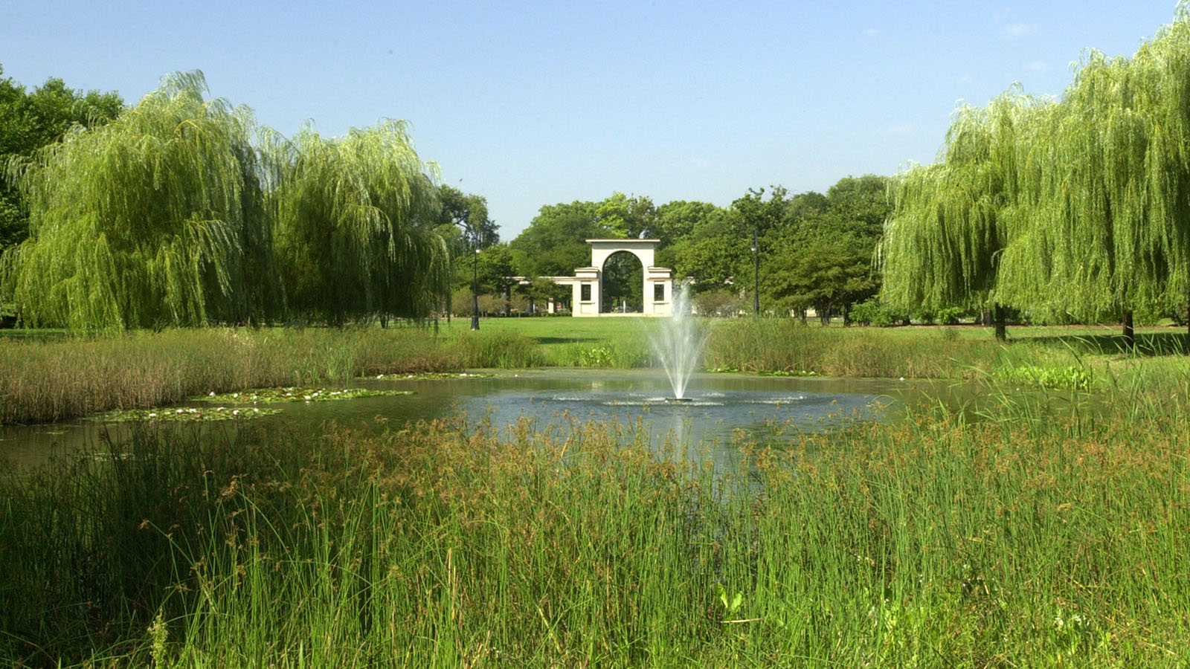
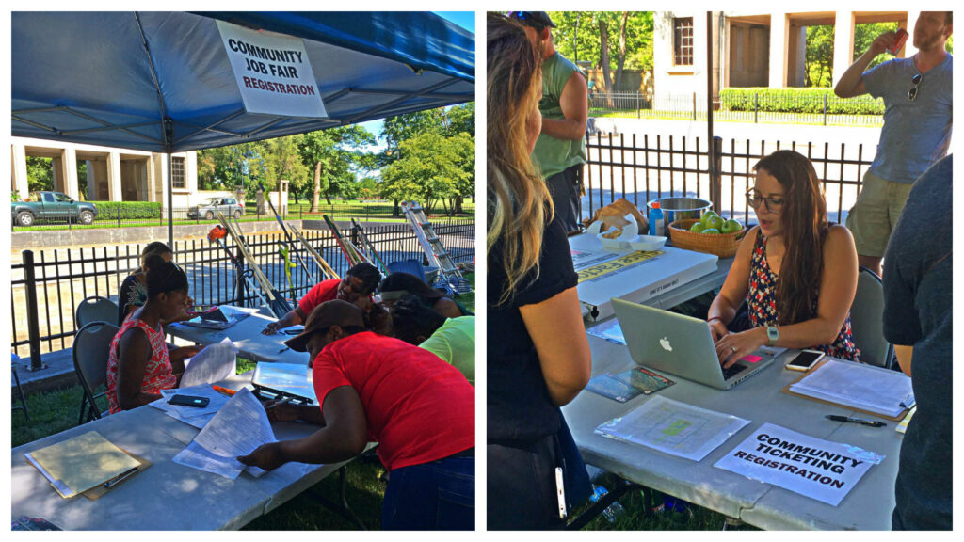
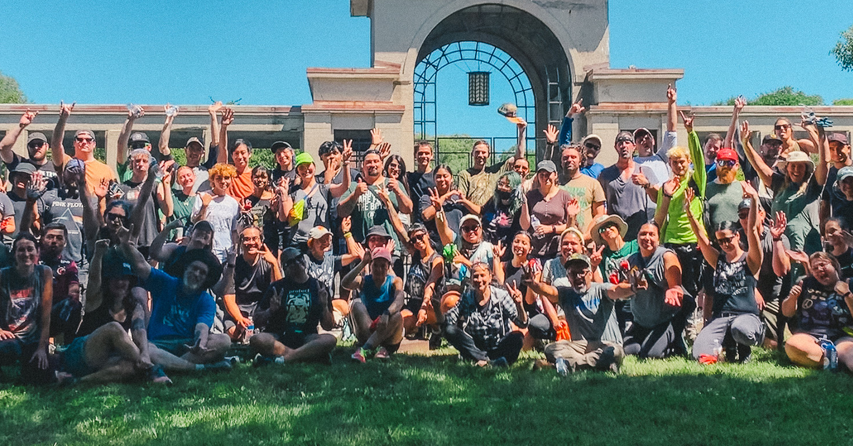
JOB FAIRS, PARK CLEANUPS & TICKETS
EMPLOYMENT, ENVIRONMENT, ENTERTAINMENT
LOCAL JOB FAIRS
June 22 | August 10 | August 17
Over 800 Applications in 2023
230 People hired locally to work at Riot Fest
Looking to hire 300+ in 2024
PARK CLEANUPS
June 22 | August 12 | October 5
Riot Fest attendees have a chance to earn their tickets by volunteering to help with Douglass Park cleanups
Mulching trees, cleaning the park and playground maintenance
Over 150 Volunteers in 2023
TICKET GIVEAWAYS
June 22 | August 12 | August 17
If you live within approximately 4 blocks of Douglass Park, you can register for free tickets to Riot Fest every year!
1,500 Tickets in 2023

Slide 13
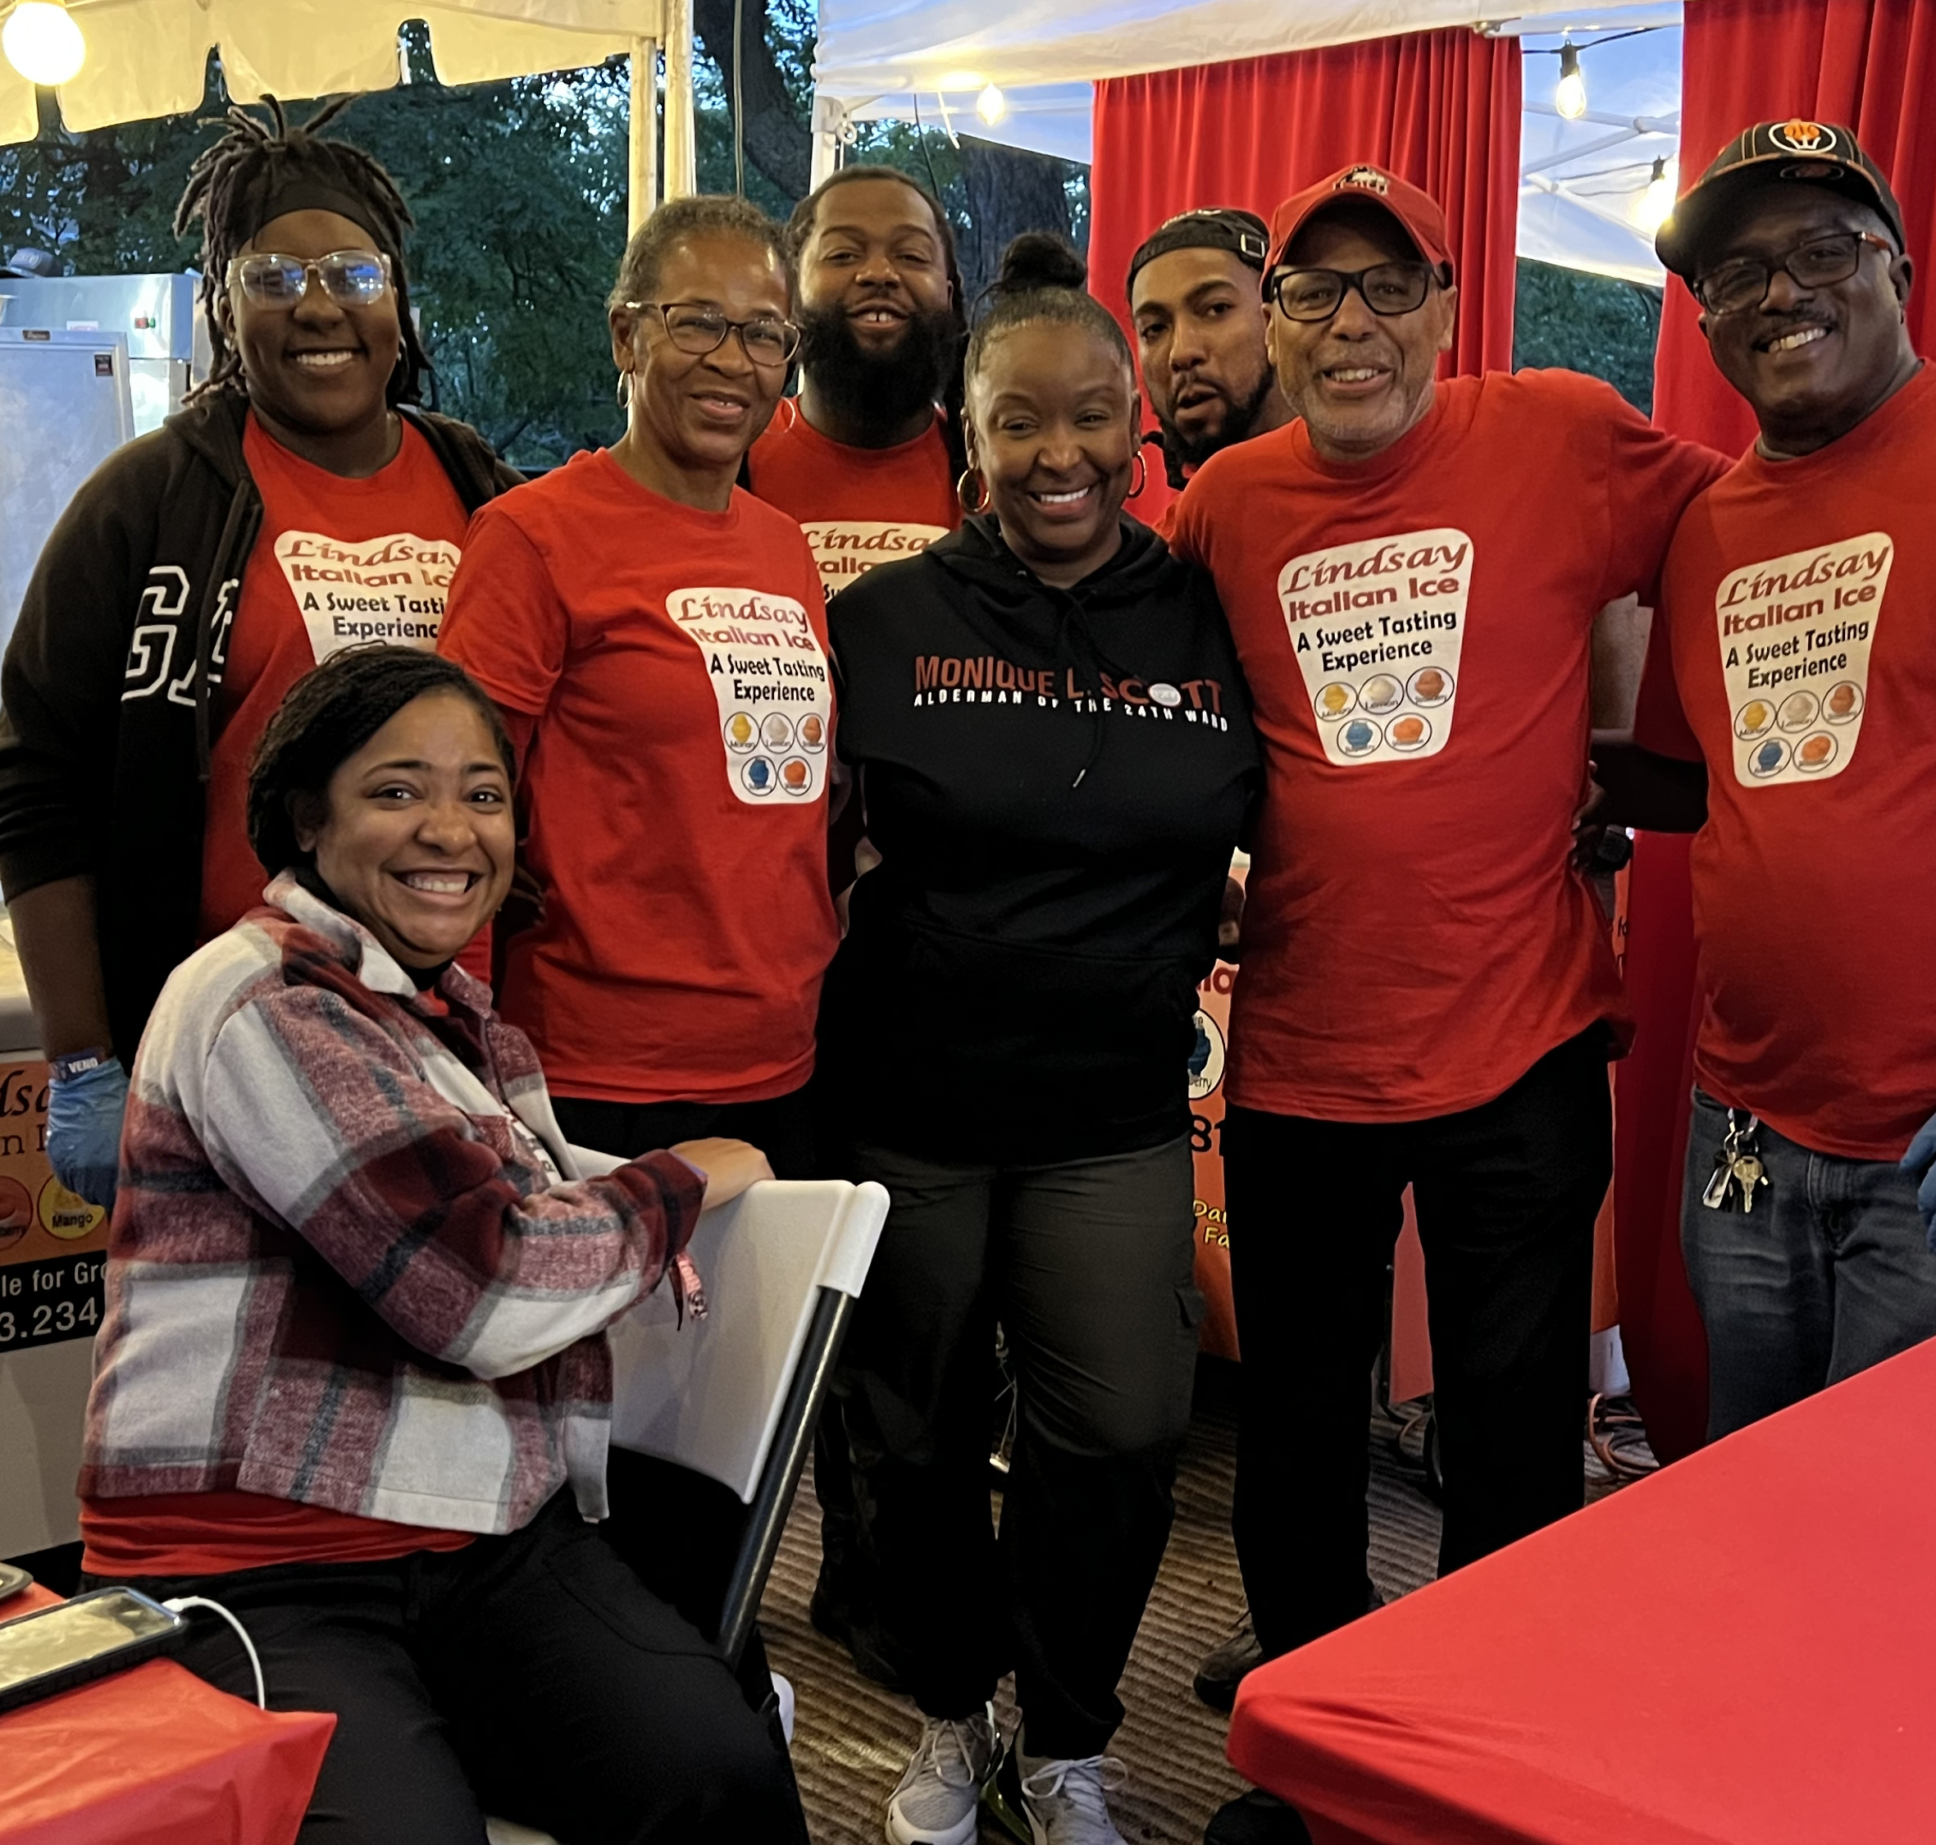
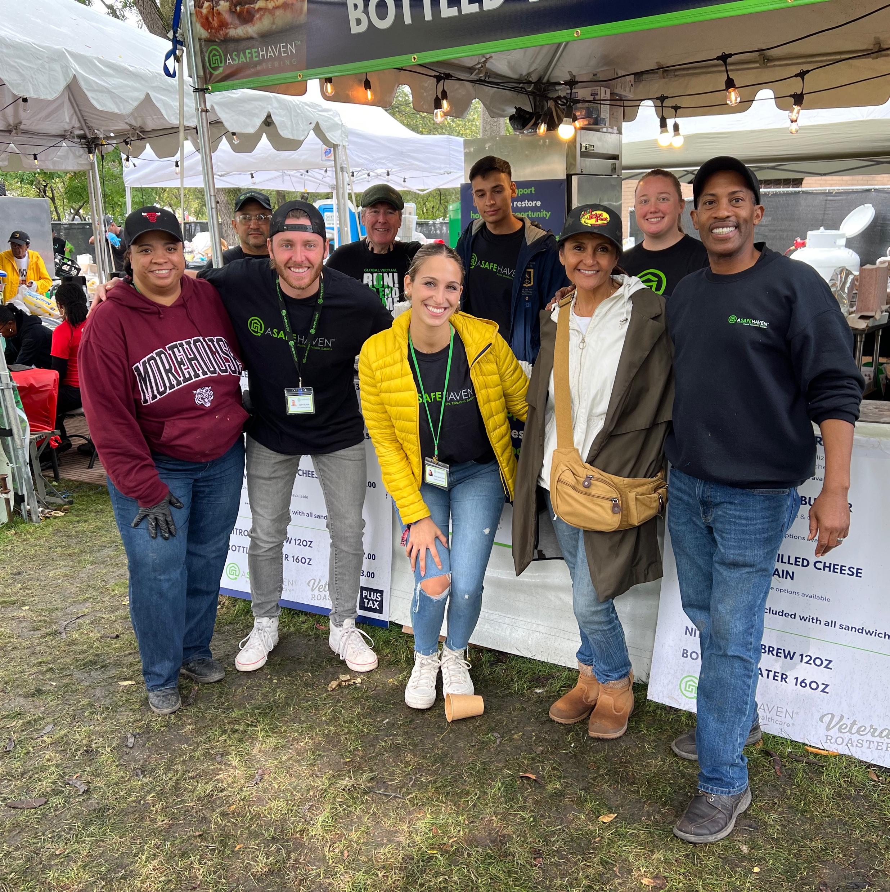
2023 COMMUNITY SMALL BUSINESSES
INCLUSION FOR LOCAL BUSINESSES AT THE FESTIVAL
LOCAL RESTURANTS
Lindsay Italian Ice
Douglass 18
A Safe Haven Catering
Ida's Ice Cream
Los Comales
Bombon Cake Gallery
Yum Yum Lemonade
Brunch N Burgers
Box Lunch Cafe
Corgwell Catering
Taqueria Mi Lindo Mexico
3 Kings Jerk
LOCAL ARTISANS & PARTNERS
24th Ward Alderwoman Monique Scott
Douglass Park Advisory Council
Helen & Joe - Dia de Los Muertos Canvas
Boxing Out Negativity – Boxing RIng
Open Books - Lawndale Pop Up
Weekenz Boutique
Bar None
Instituto Progresando
Pilsen Chamber
Village Leadership Academy

Slide 14
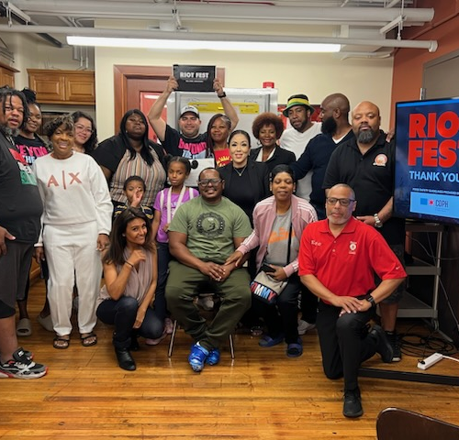
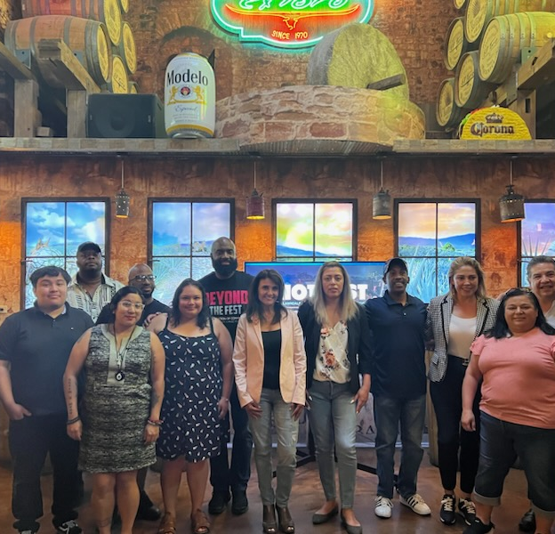
COMMUNITY VENDOR WORKSHOP 2024
ELEVATING LOCAL BUSINESSES AT RIOT FEST & BEYOND
Welcome back to our Community Vendor Workshop! Once again, designed with North Lawndale and Little Village businesses in mind, this workshop is here to arm you with the essential tools for success at local events, such as Riot Fest. Join us on this renewed journey to elevate your visibility, deepen community ties, and expand your business opportunities.
OBJECTIVE
Deepen understanding of the evolving requirements for participating in Riot Fest 2024 and other key Chicago events and festivals.
Update knowledge on the latest in equipment needs, food and safety regulations, food distribution practices, staffing models, rental costs, and budgeting strategies.
Gain enriched insights and innovative strategies from Riot Fest organizers and successful vendors to maximize success
FREE BOOTH
To encourage participation, we are offering 5 free food booths to new eligible businesses. Returning vendors will receive a 20% discount, limit of (5). New or returning non-profit organizations will receive a free booth. *Businesses must complete one of two workshops to qualify.
WORKSHOP DATES
Saturday, June 1, 2024 12pm to 2pm
New location TBA
Sunday, June 2, 2024 12pm to 2pm
New location TBA
REGISTRATION
Registration opens – April 17, 2024
Registration deadline – May 24, 2024
REGISTER: RIOTFEST.ORG/COMMUNITY

Slide 15
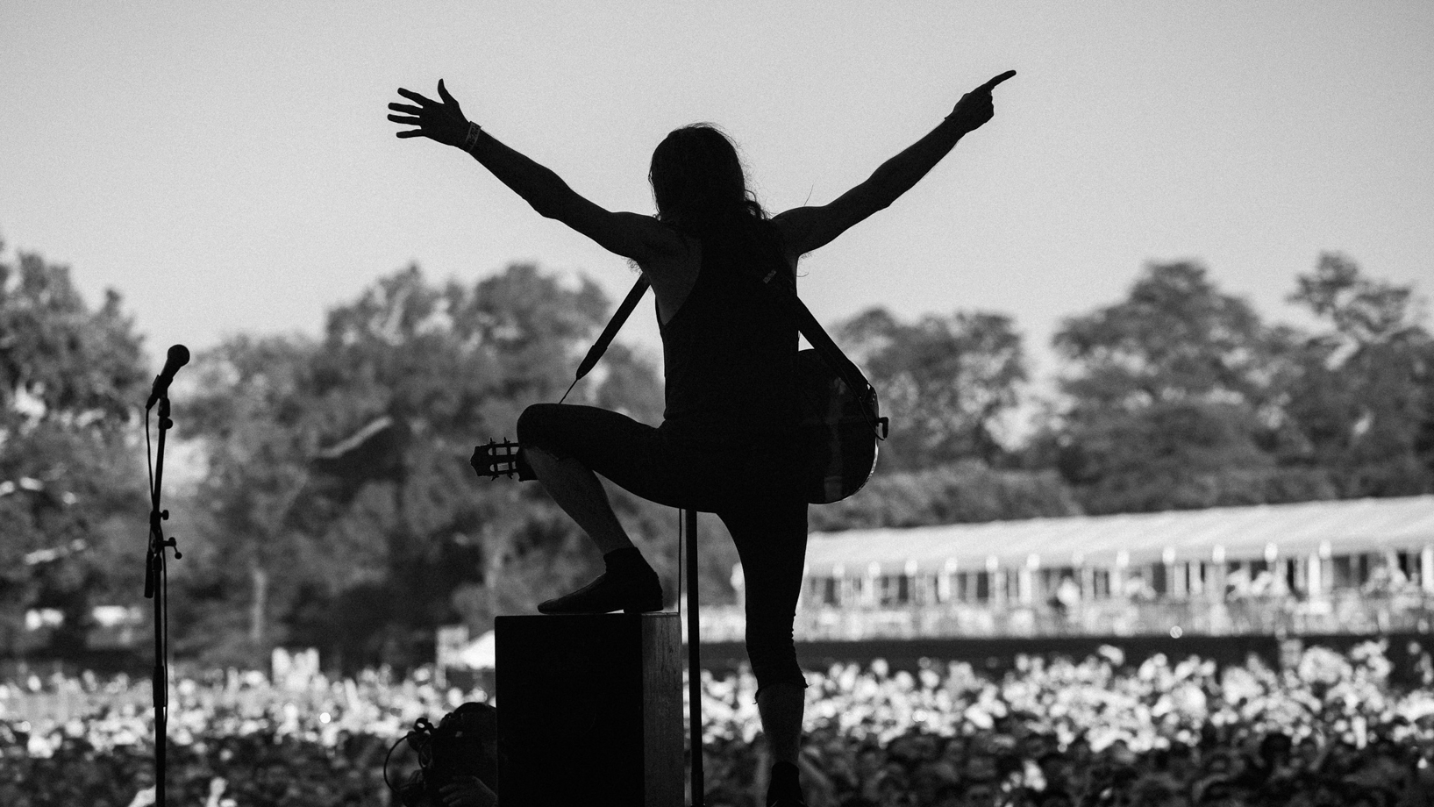
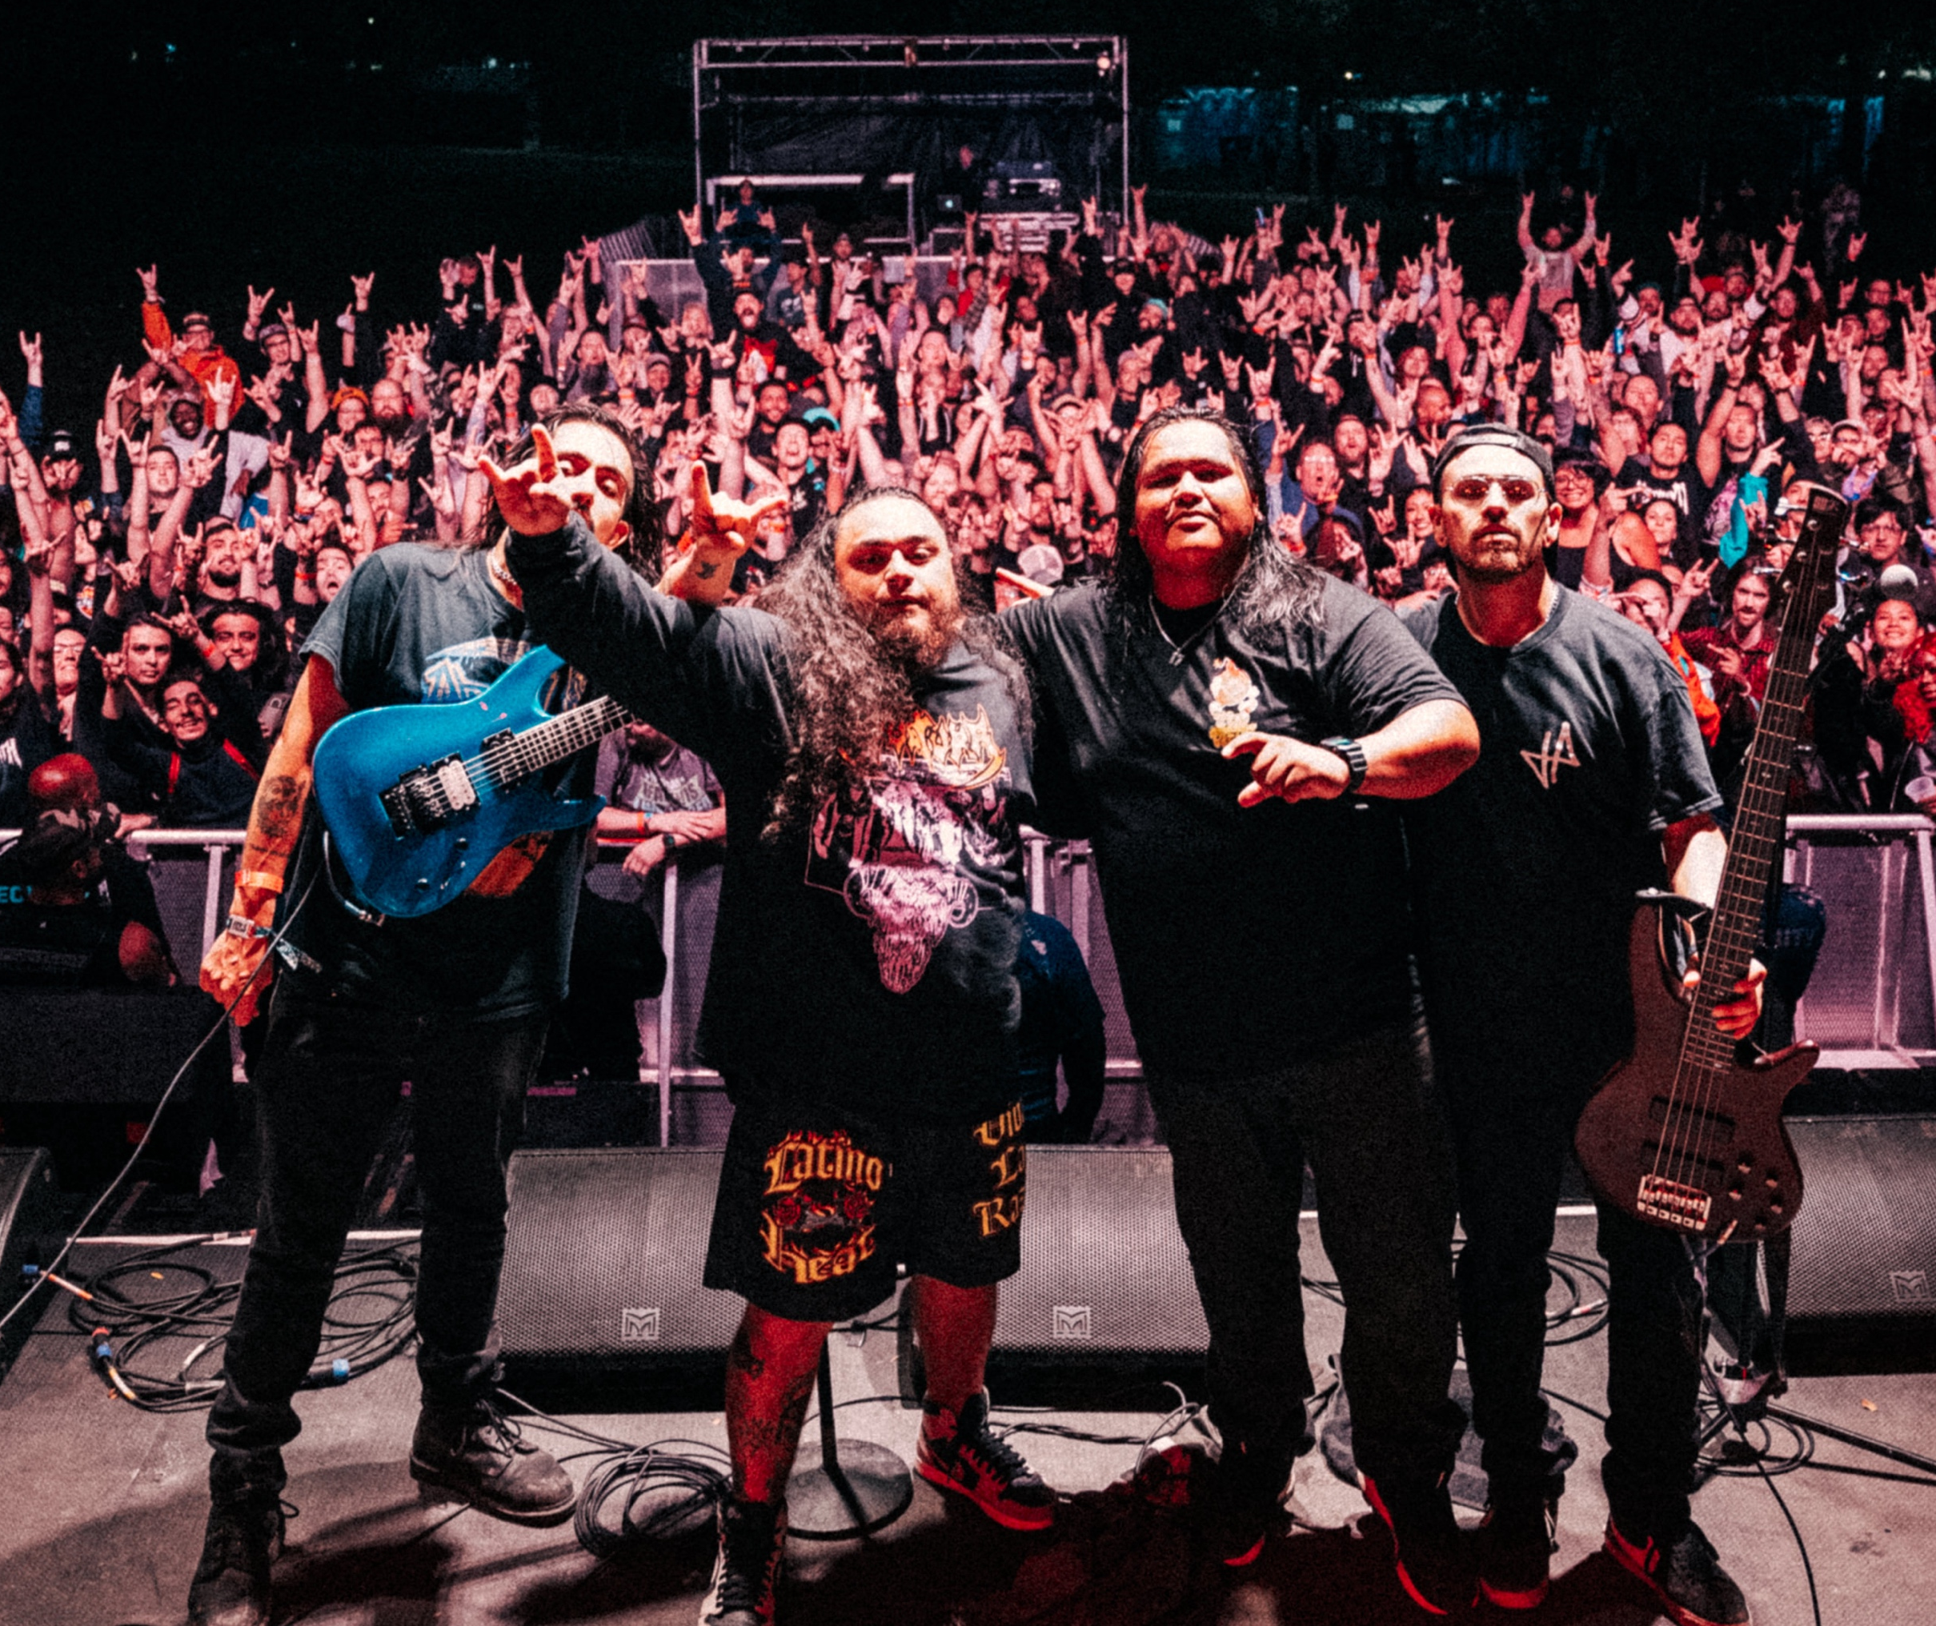
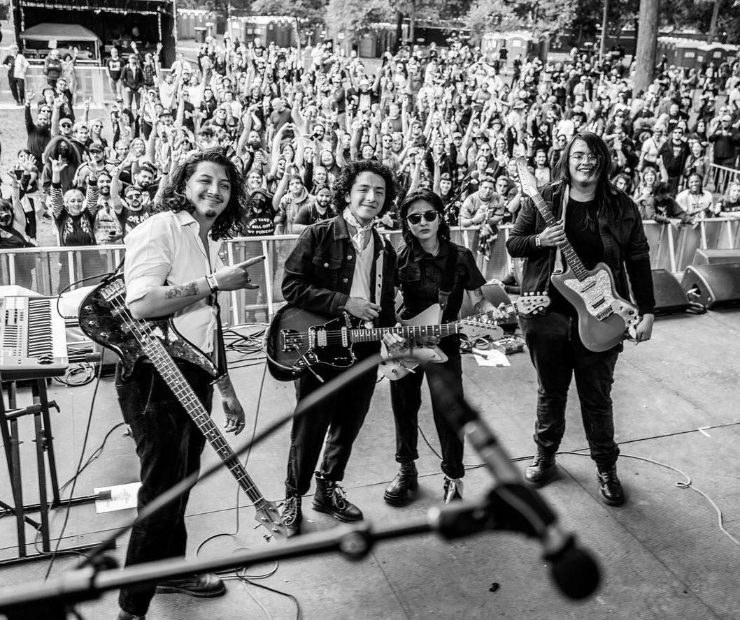
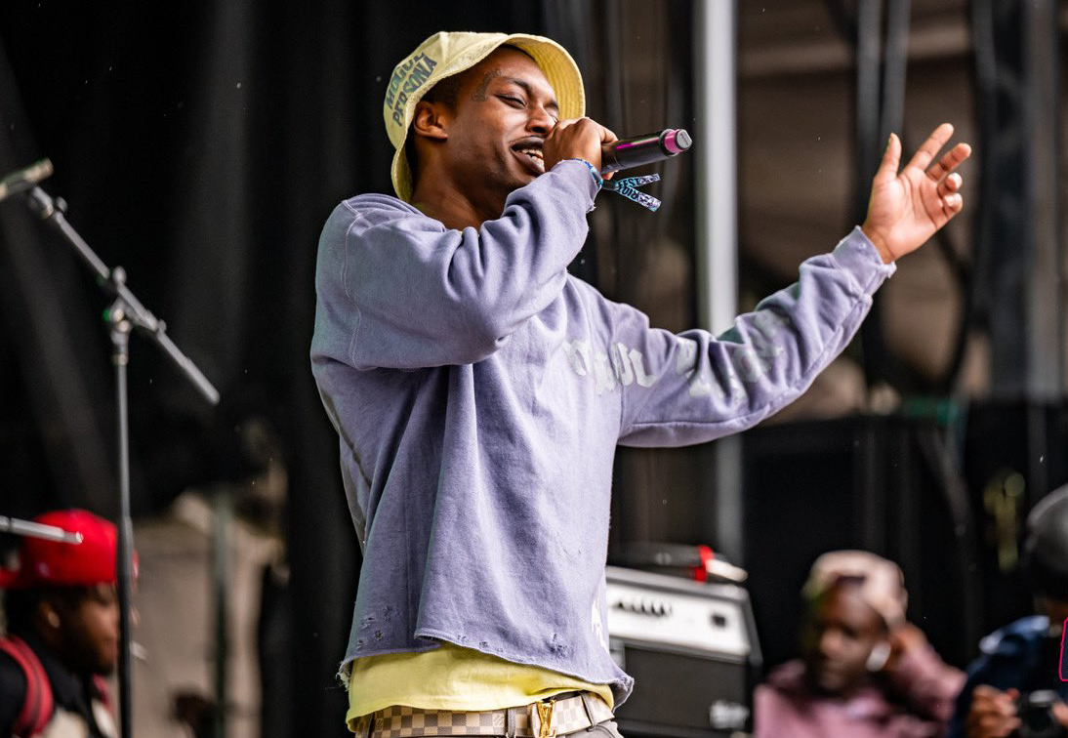
SUPPORTING LOCAL TALENT AT RIOT FEST
PROVIDING A PLATFORM FOR RISING STARS
Riot Fest is thrilled to once again offer an exhilarating opportunity for local artists from the North Lawndale and Little Village communities. Continuing our tradition from last year, we are opening our stage for local talent to shine and share their artistry on one of the world's most prestigious platforms. In our ongoing commitment to support and spotlight community talent, we will be selecting three outstanding artists from these neighborhoods to take center stage at Riot Fest 2024.
KEY POINTS:
Artist Registration: April 8, 2024 – Online submission at Riotfest.org
Selection Process: Artists will submit their songs to for consideration, with our panel of guest judges choosing the top three finalists
Performance Opportunity: The selected artists will take center stage at Riot Fest 2024
BENEFITS FOR SELECTED ARTISTS:
Booking Fee: Artists will receive a fee for their performance
Promotion: Inclusion on Riot Fest's website and social media channels
Media Exposure: Scheduled interviews with select media outlets
Marketing Presence: Artist's name featured on flyers, posters and other promotional material
Networking Opportunity: Exclusive access to 'Artist World', an environment to connect with fellow musicians and industry professionals

Slide 16
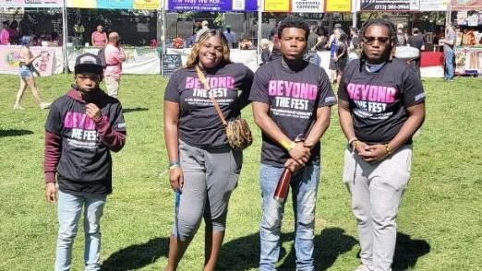
RIOT FEST INTERNSHIP PROGRAM
EXPANDING OPPORTUNITIES FOR OUR YOUTH
OPPORTUNITY EXPANDED
Elevating our unique paid internship initiative, this year we're inviting 10 enthusiastic youths to immerse themselves in the vibrant world of Riot Fest.
DEEPER DISCOVERIES
Interns will gain an insider’s look at Riot Fest's operations through comprehensive interactions with department heads, insightful inquiries, and detailed tours of the festival’s extensive infrastructure.
ENHANCED FESTIVAL INSIGHTS
Our interns will explore a wider array of festival organization and production facets, deepening their comprehension of the event’s complexities.
EXPANDED NETWORKING GOLDMINE
Interns will connect with an even broader network of industry pioneers, musicians, and production teams, opening doors to future opportunities in the entertainment sphere.
EMPOWERING THE FUTURE
We are dedicated to nurturing our community's youth by offering more spots in our Paid Internship Program, thus providing them with unparalleled experiences in the entertainment industry and fostering their growth.
Registration Opens: July 23, 2024

Slide 17
2023 ECONOMIC IMPACT
BOOSTING THE LOCAL ECONOMY
CITY & PARK DISTRICT FEES
CITY & COUNTY TAXES & FEES - $2 Million +
PARK RENTAL FEE - $680k
$2.68M +
INVESTING IN OUR COMMUNITIES
VENDORS & NON - PROFITS BOOTHS $123K
LOCAL TICKET GIVEAWAYS - $322k
EVENTS & INITIATIVES - 89K
LOCAL JOBS - $124k
$658K

Slide 18
COMMUNITY ENGAGEMENT
IN - PERSON & INDIVIDUAL ENGAGEMENTS
Our Community Engagement initiative is designed to foster closer relationships and enable more substantive discussions beyond the confines of virtual meetings. We are pleased to offer in-person gatherings, creating spaces for face-to-face dialogue where community members can engage deeply on matters that are important to them. Additionally, recognizing the unique needs and preferences of our community, we are also making provisions for individual meetings.
This approach allows for personalized conversations, ensuring that everyone has the opportunity to share their thoughts, ask questions, and contribute to our collective goals. Whether through group sessions or one-on-one discussions, our aim is to strengthen community bonds and foster an environment of open communication and mutual support.
IN- PERSON MEETINGS
Saturday, April 27th , 2024 | Session 1: 1pm to 2pm - Session 2: 3pm – 4pm
Register on April 2nd , 2024 Riotfest.org/community
RIOT FEST PRESENTS
INDIVIDUAL MEETINGS
Email: community@riotfest.org
VIRTUAL MEETINGS
Friday, September 13th , 2024 | 7pm
Providing updates before the festival
Friday, October 25th , 2024 | 7pm
Festival Recap

Slide 19
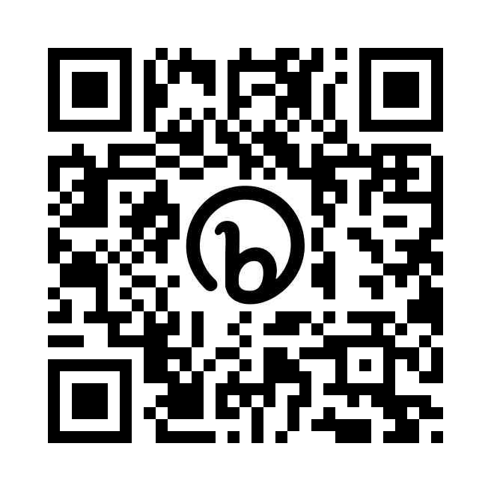
THANK YOU!
GUEST SPEAKERS
Q&A
RIOTFEST.ORG/COMMUNITY
CONTACT US: COMMUNITY@RIOTFEST.ORG

